Slide 1
2023 Economic Analysis of Animal Agriculture
United Soybean Board

Slide 2
Objectives
Economic impact of animal agriculture to local (state) economies from 2012-2022
Soybean Meal (SBM) usage by animal species during the 2021/2022 soybean marketing year
Animal Unit (AU) trends from 2012-2022

Slide 3

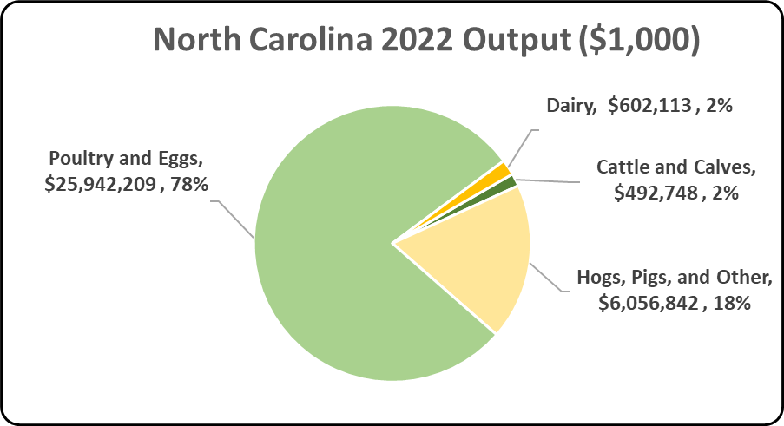
Notes:
The figure illustrates the impact of animal agriculture to the North Carolina economy. Animal agriculture’s impact on North Carolina total economic output is about $33.1 billion.

Slide 4
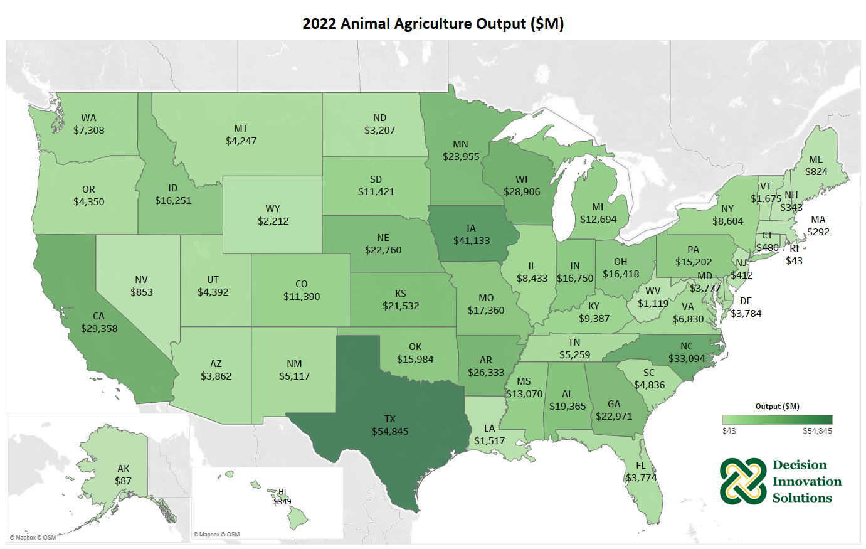
Notes:
Animal agriculture is an important piece to the U.S. economy and helped generate $568.2 billion of output in 2022. The top 5 leading states for animal agriculture in terms of output include Texas ($54.8 billion), Iowa ($41.1 billion), North Carolina ($33.1 billion), California ($29.4 billion), and Wisconsin ($28.9 billion). Table 14 lists the total output, earnings, employment, and income taxes paid in 2022, for each state.

Slide 5
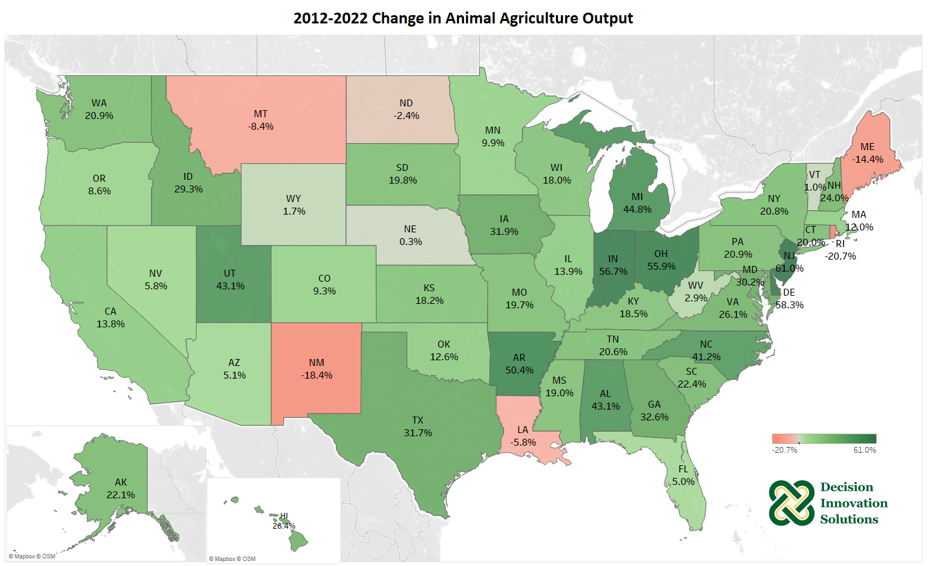
Notes:
Most states across the U.S. saw an increase from 2012 to 2022 in the amount of output supported by animal agriculture. New Jersey, Delaware, Indiana, Ohio and Arkansas were the leading states for total dollar increases in animal agriculture output. Table 15 lists the changes in output, earnings, employment, and income taxes paid from 2012 to 2022 for each state.

Slide 6
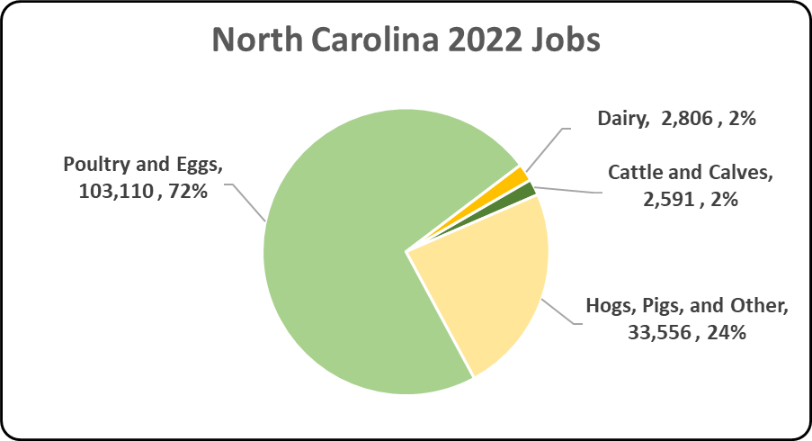
Notes:
The figure illustrates the contribution to North Carolina in terms of animal agriculture jobs. As shown, animal agriculture contributes significantly to North Carolina total jobs, contributing 142,062 jobs within and outside of animal agriculture.

Slide 7
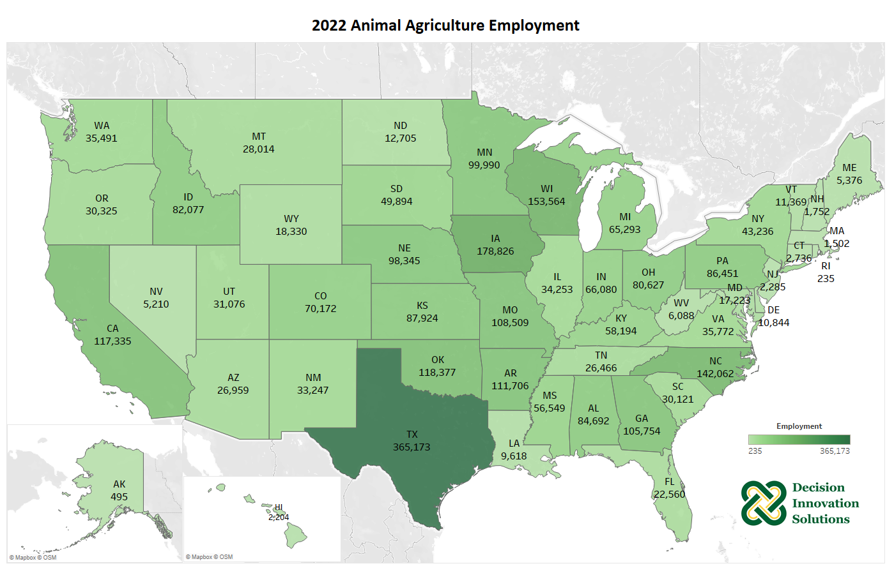
Notes:
In 2022, animal agriculture supported 2.8 million jobs in the U.S. There are nine states where this sector is especially robust and supports over 100,000 jobs: Texas (365,173), Iowa (178,825), Wisconsin (153,564), North Carolina (142,062), Oklahoma (118,377), California (117,335), Arkansas (111,706), Missouri (108,509) and Georgia (105,754).

Slide 8
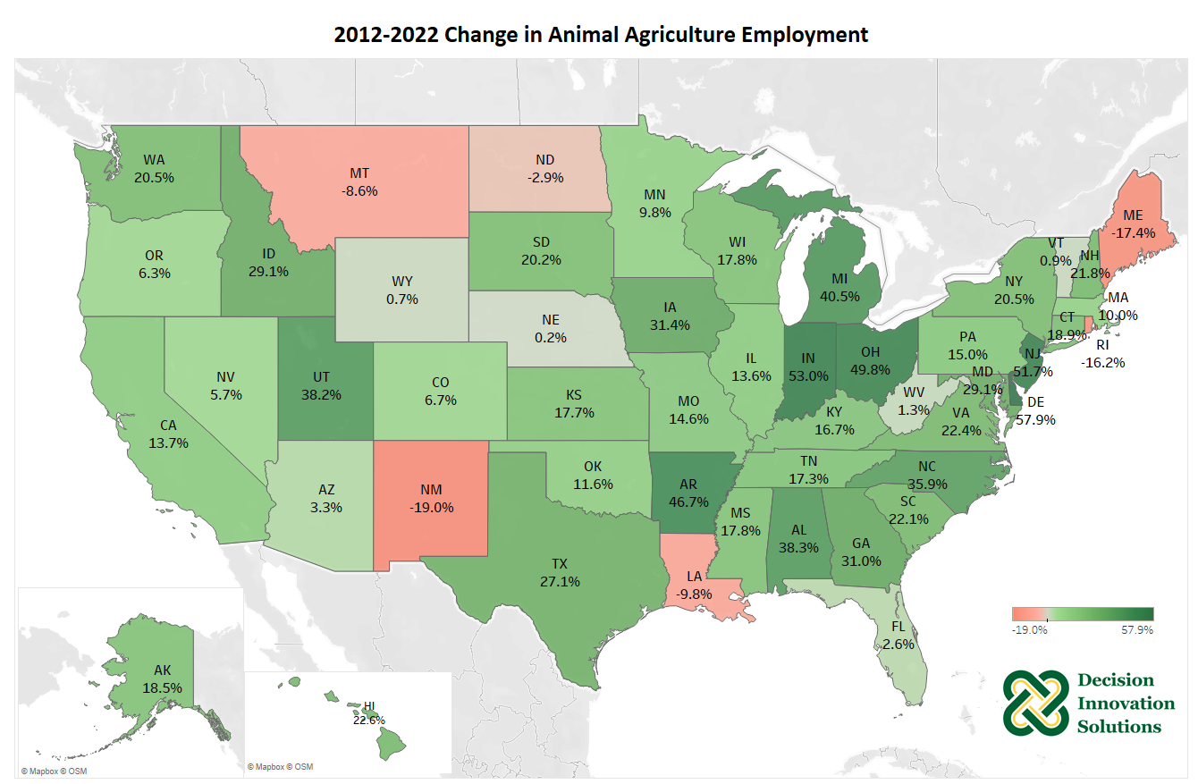
Notes:
Animal agriculture supported increases in jobs in many Midwest and east and west coast states over the past decade. Only six states have declined from 2012 to 2022, which are New Mexico, Maine, Rhode Island, Louisiana, Montana and North Dakota.

Slide 9
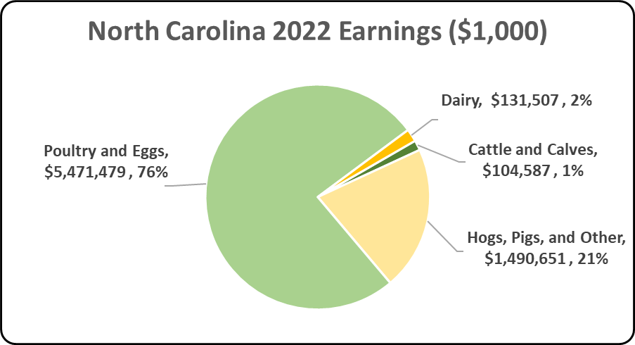
Notes:
The figure illustrates the impact of animal agriculture to the North Carolina economy in terms of earnings. North Carolina’s animal agriculture contributed about $7.2 billion to household earnings in 2022.

Slide 10
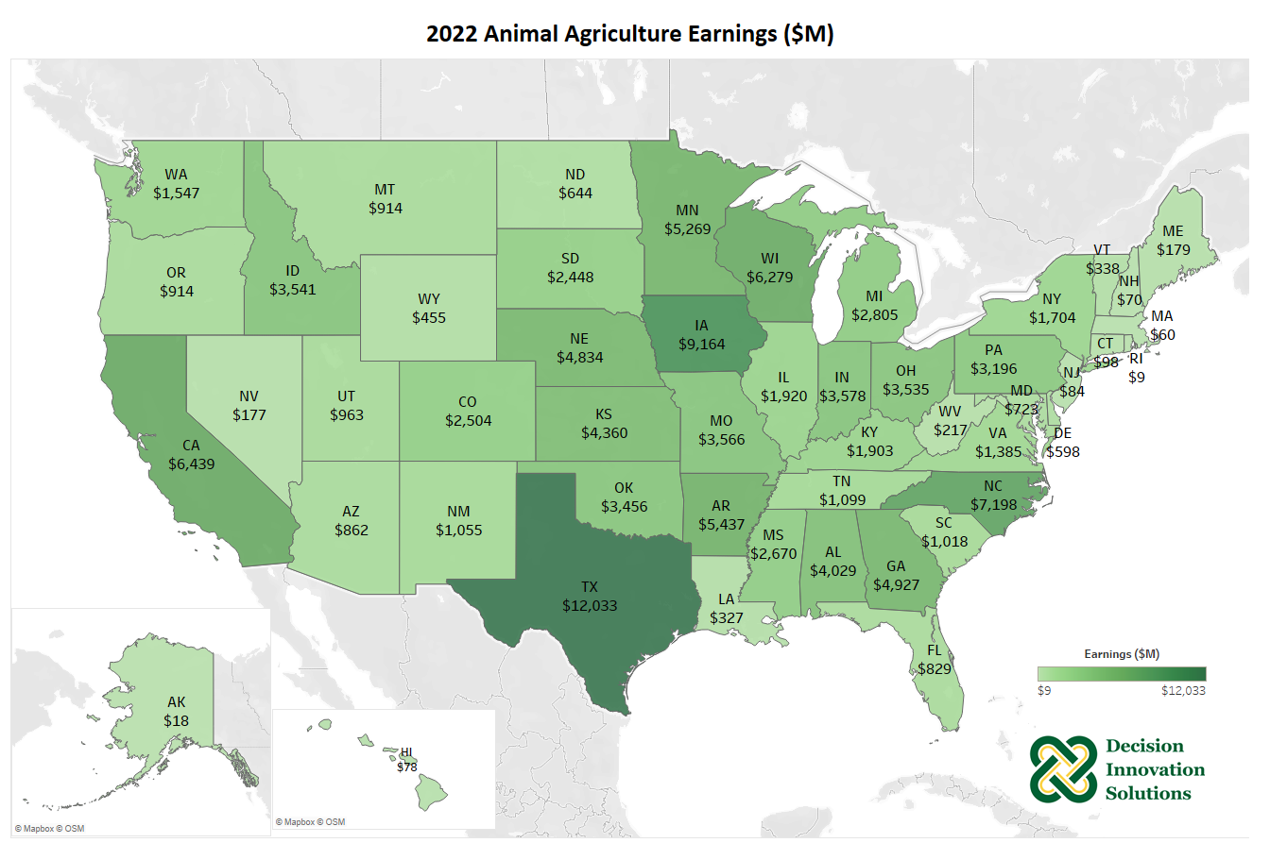
Notes:
Earnings are an important component of a local economy since they allow households to invest capital and spend currency that trades hands many times, generating additional economic activity. Animal agriculture helped generate nearly $121.46 billion in household earnings in the U.S. in 2022 and contributes heavily to earnings in many states such as Texas ($12.0 billion), Iowa ($9.2 billion), North Carolina ($7.2 billion), California ($6.4 billion), Wisconsin ($6.3 billion), and many more.

Slide 11
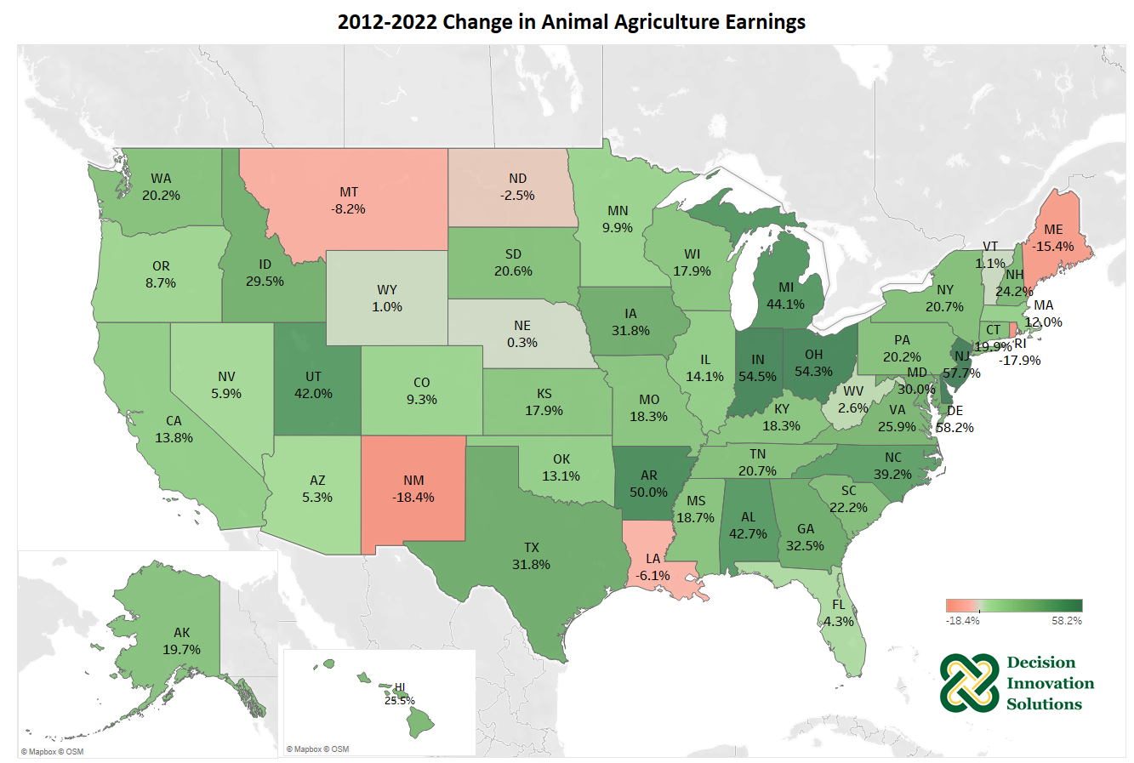
Notes:
Many Midwest and east and west coast states have seen increased earnings generated from the animal agriculture sector over the past decade, led by Delaware, New Jersey, Indiana, Ohio and Arkansas. Only six states have declined from 2012 to 2022, which are New Mexico, Maine, Rhode Island, Louisiana, Montana and North Dakota.

Slide 12
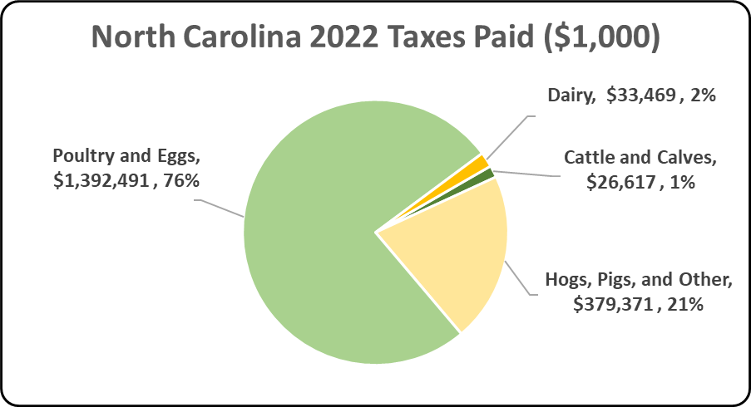
Notes:
In 2022, the state’s animal agriculture industry paid about $1.8 billion in income taxes at local, state, and federal levels. The 2017 Census of Agriculture estimated $157.4 million in property taxes paid by all of North Carolina agriculture during 2017. Estimates of income taxes paid by animal agriculture are shown in the following chart.

Slide 13
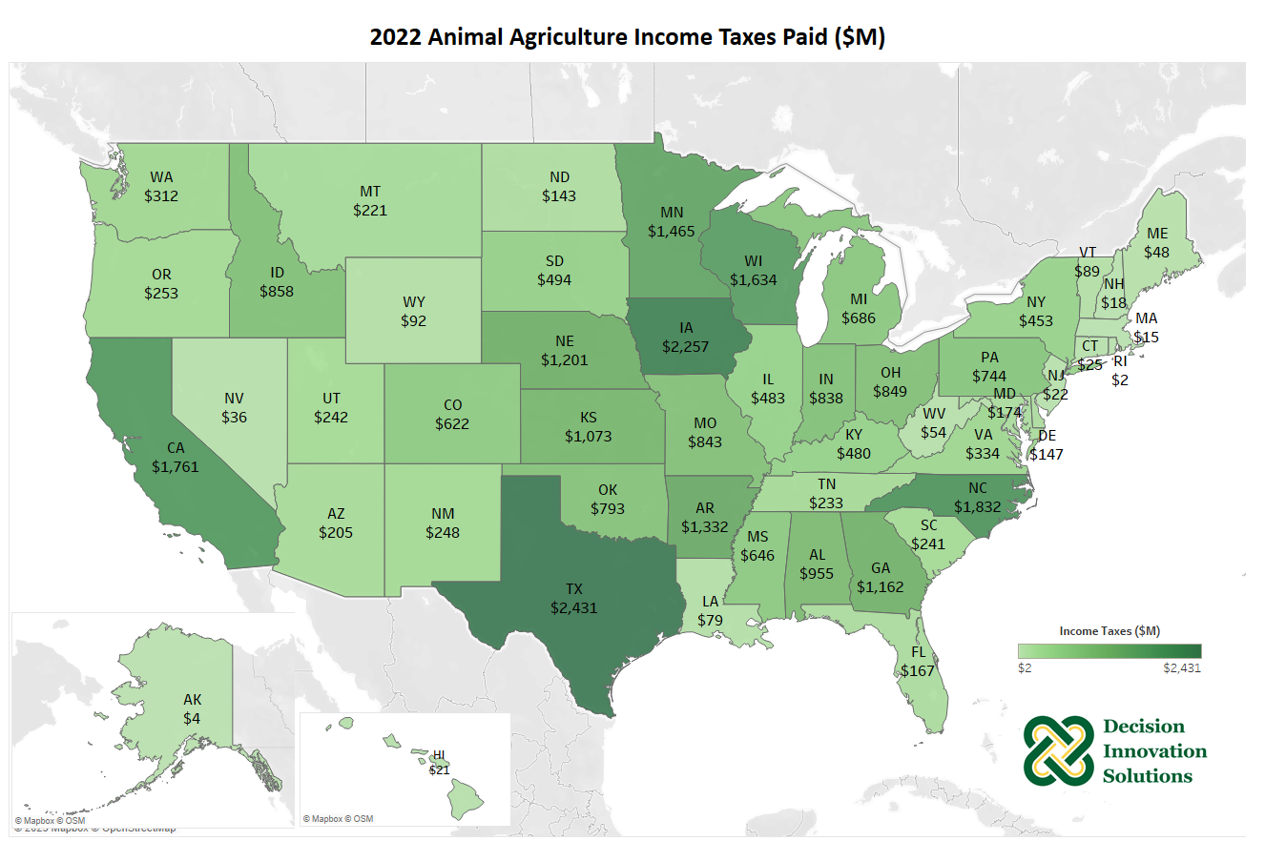
Notes:
In addition to the large amounts of economic activity derived from animal agriculture across the country, animal agriculture plays an important part in supporting local, state and federal taxing jurisdictions. A direct relationship to the size and scope of animal agriculture yields significant income tax payments in states such as Texas, Iowa, North Carolina, California, and Wisconsin. In the U.S., animal agriculture paid taxes estimated at $29.3 billion 2022.

Slide 14
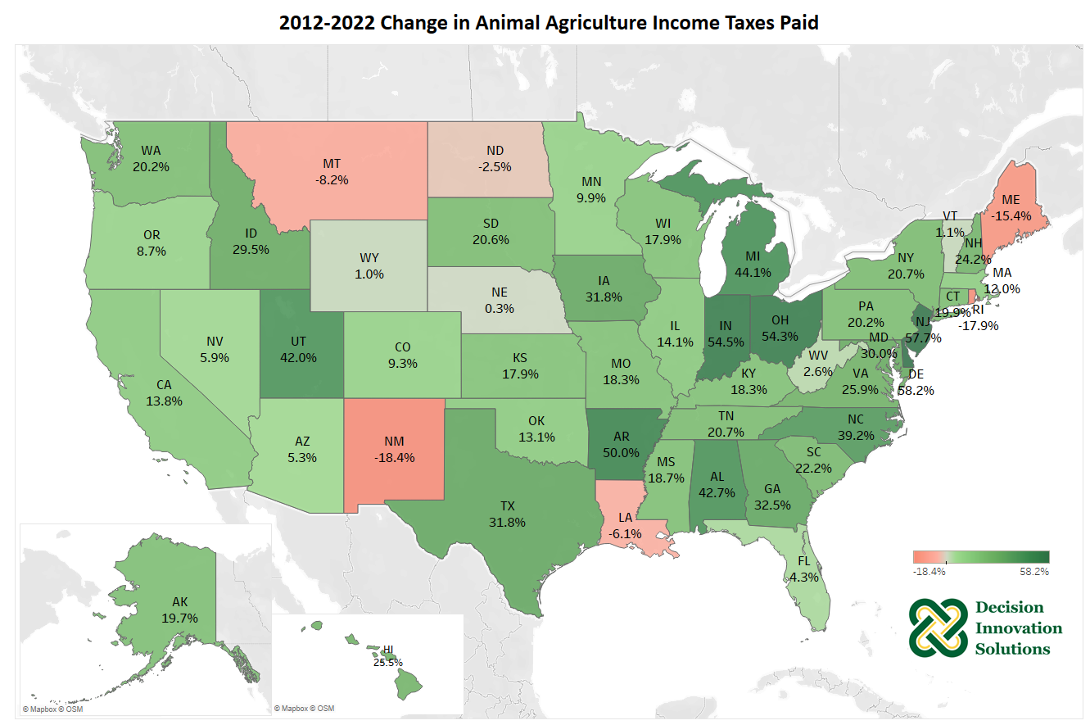
Notes:
Income taxes paid at the local, state, and federal jurisdictions increased steadily over the last decade. Delaware, New Jersey, Indiana, Ohio and Arkansas, were among the top five states for total dollar growth in estimated income tax payments. Only six states saw growth decreased in income taxes paid by animal agriculture from 2012 to 2022.

Slide 15
North Carolina Animal Agriculture Multipliers
Notes:
Multipliers are generally stated in the form of “per million dollars” of output. As it relates to this analysis, multipliers are stated as the activity related to every million dollars of economic output in animal agriculture. Referring to the multipliers below, for every million dollars in output generated by the various segments of animal agriculture in North Carolina, $1.88 to $2.99 million in total economic activity, $0.40 to $0.63 in household wages and 10 to 12 additional jobs are generated in the economy at large.

Slide 16
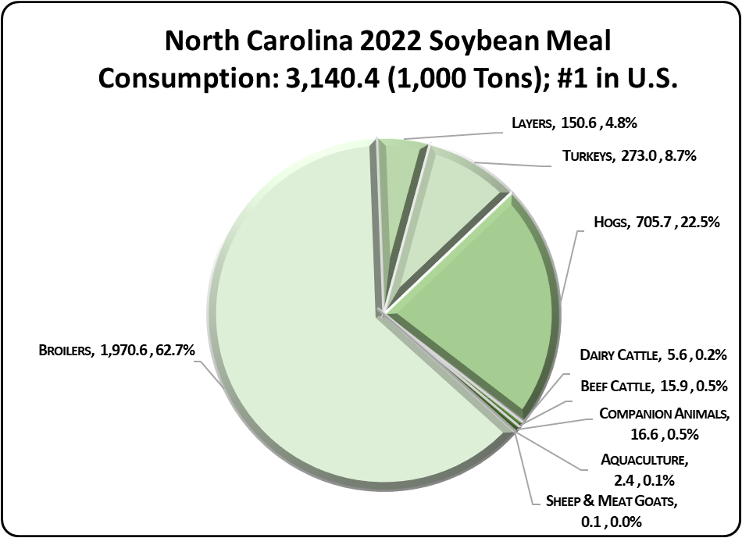
Notes:
North Carolina’s animal agriculture consumed more than 3.1 million tons of SBM in 2022, placing the state as 1 in the nation in terms of SBM consumption (see figure below). Additionally, animal agriculture in North Carolina consumed 79.5 thousand tons of soy hulls. The three segments of animal agriculture that led the state in estimated SBM consumption are:
Broilers (2.0 million tons)
Hogs (705.7 thousand tons)
Turkeys (273.0 thousand tons)

Slide 17
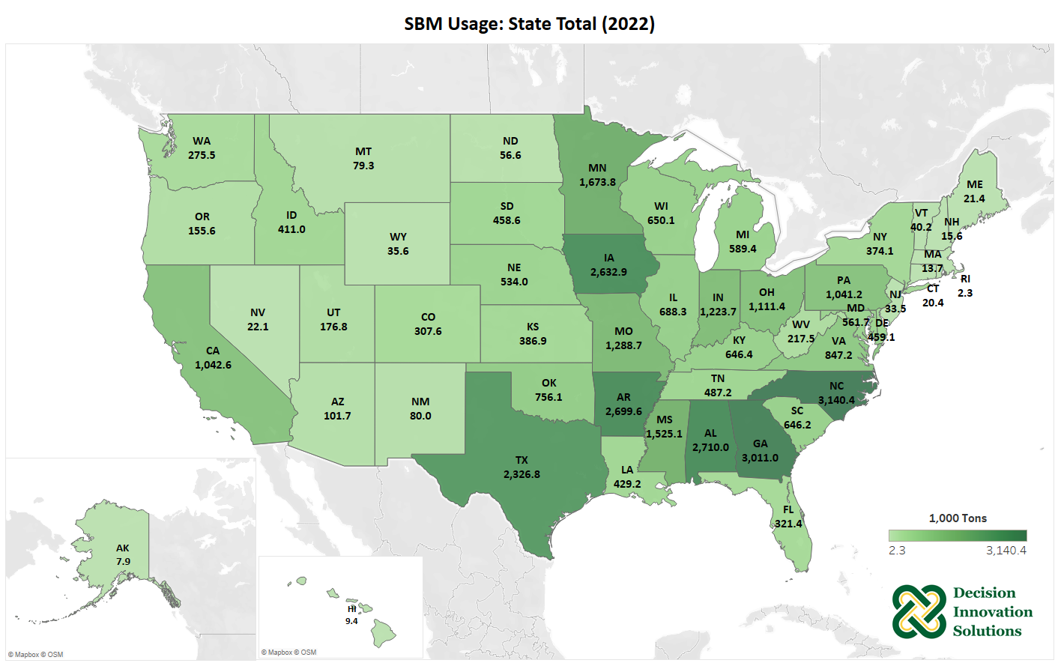
Notes:
Due to the relatively large number of hogs and broilers, North Carolina was the leader in SBM usage for 2022. Other states that used large amounts of SBM include Georgia, Alabama, Arkansas, Iowa, and Texas due to large numbers of animals (particularly broilers and hogs) in those states. Detailed results for all species including the breakdown of companion animals and aquaculture can be found in Appendix A.

Slide 18
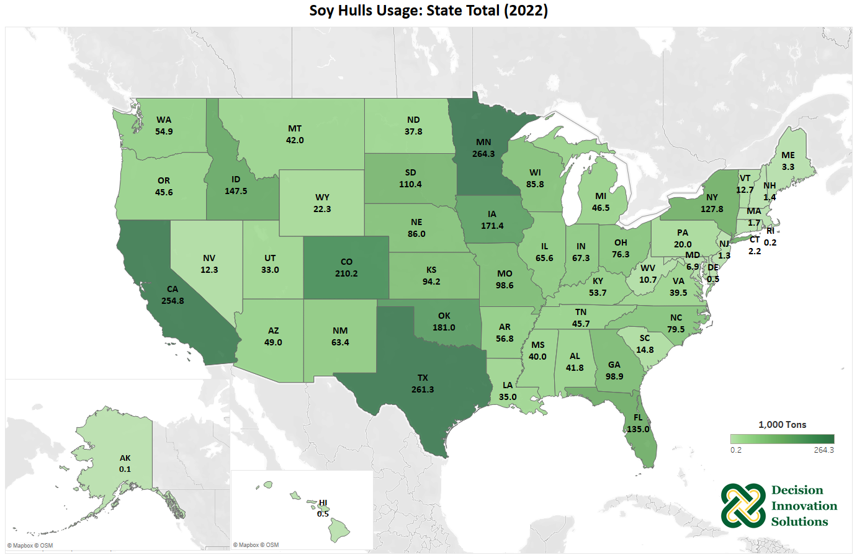
Notes:
Minnesota was the leading state for soy hulls usage since it is often used in dairy cattle and hog rations with nearly 264,327 tons consumed in 2022. Texas and California also consumed large amounts of soy hulls as the second and third largest state user respectively since it is also used in beef cattle rations (for Texas) and in dairy cattle rations (for California).

Slide 19
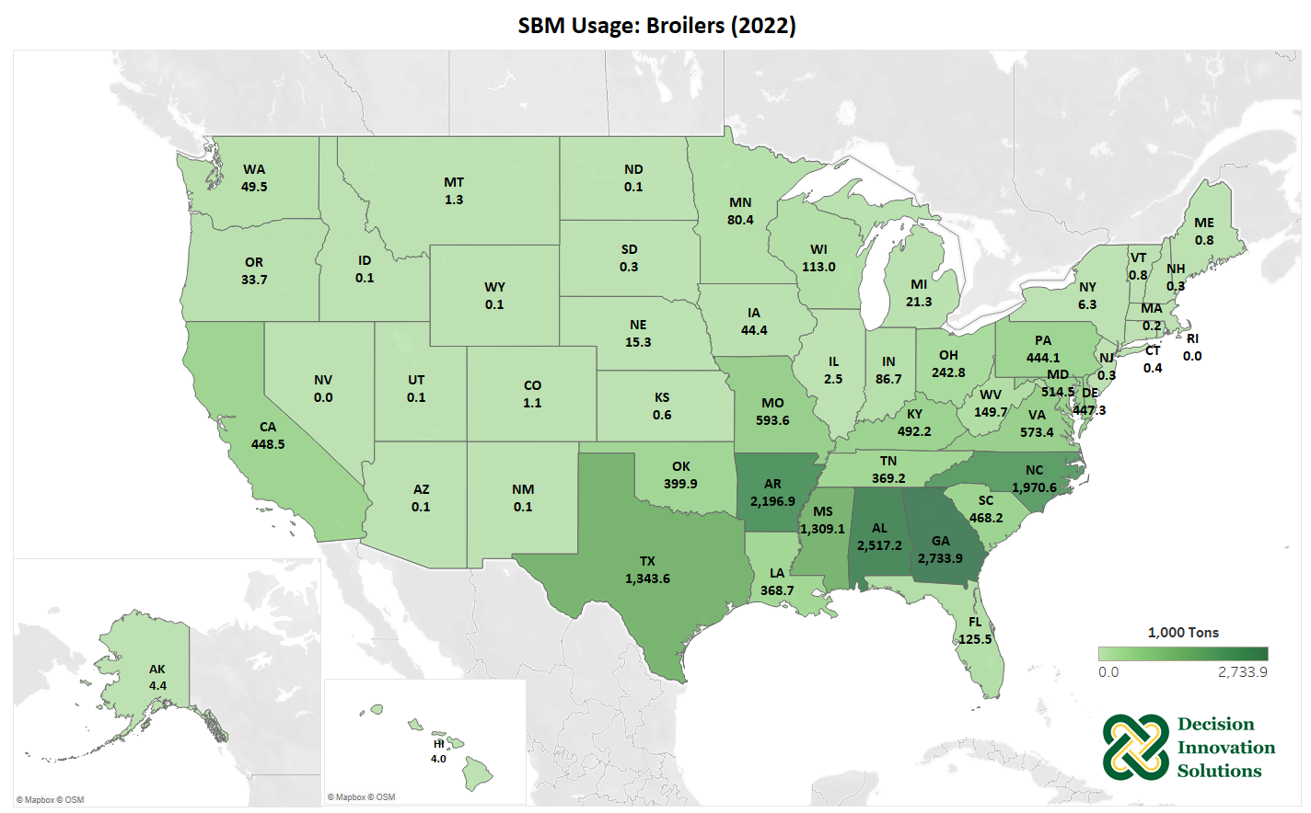
Notes:
Georgia’s broiler chickens consumed about 2.7 million tons of SBM in 2022. Other states that use significant amounts of SBM in their broiler diets are concentrated in the southeastern states including Alabama (2.5 million tons), Arkansas (2.2 million tons), North Carolina (2.0 million tons), Texas (1.34 million tons), and Mississippi (1.31 million tons).

Slide 20
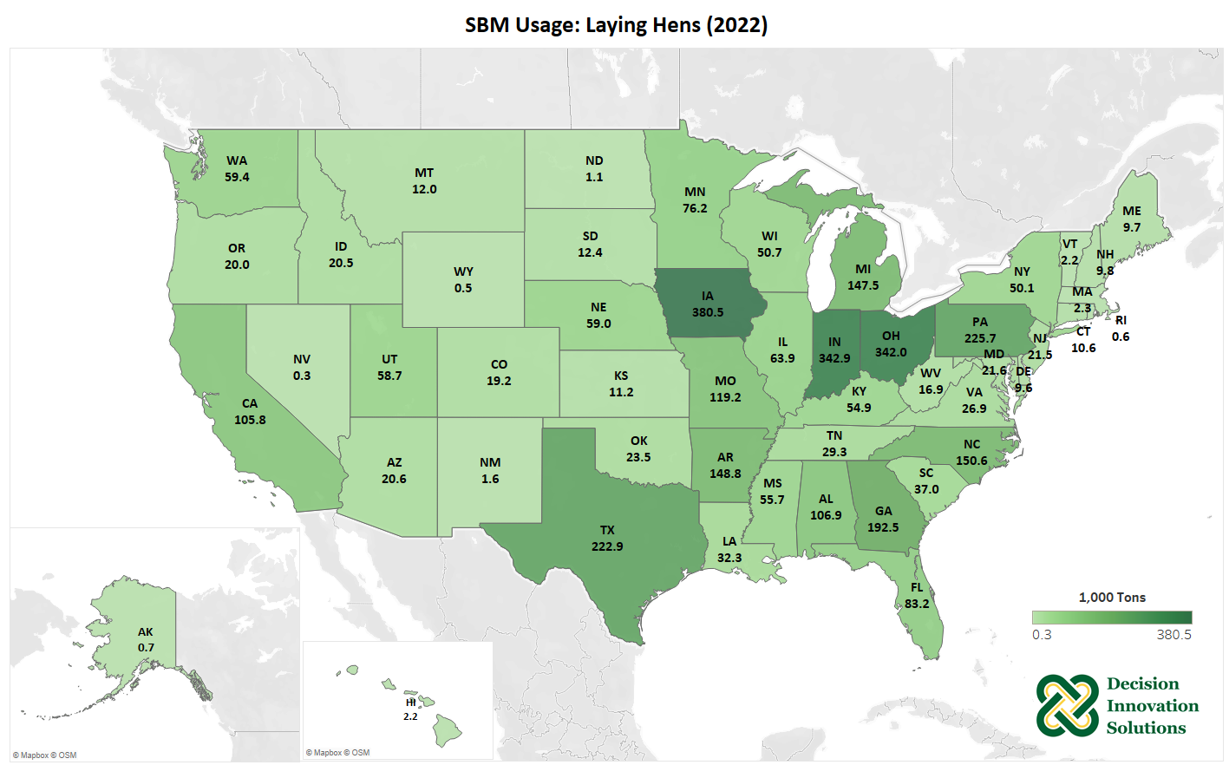
Notes:
In 2022, Iowa’s laying hens consumed about 380,472 tons of SBM. Other top states for SBM consumption by laying hens in 2022 include Indiana (342,854 tons), Ohio (342,011 tons), Pennsylvania (225,720 tons), and Texas (222,886 tons).

Slide 21
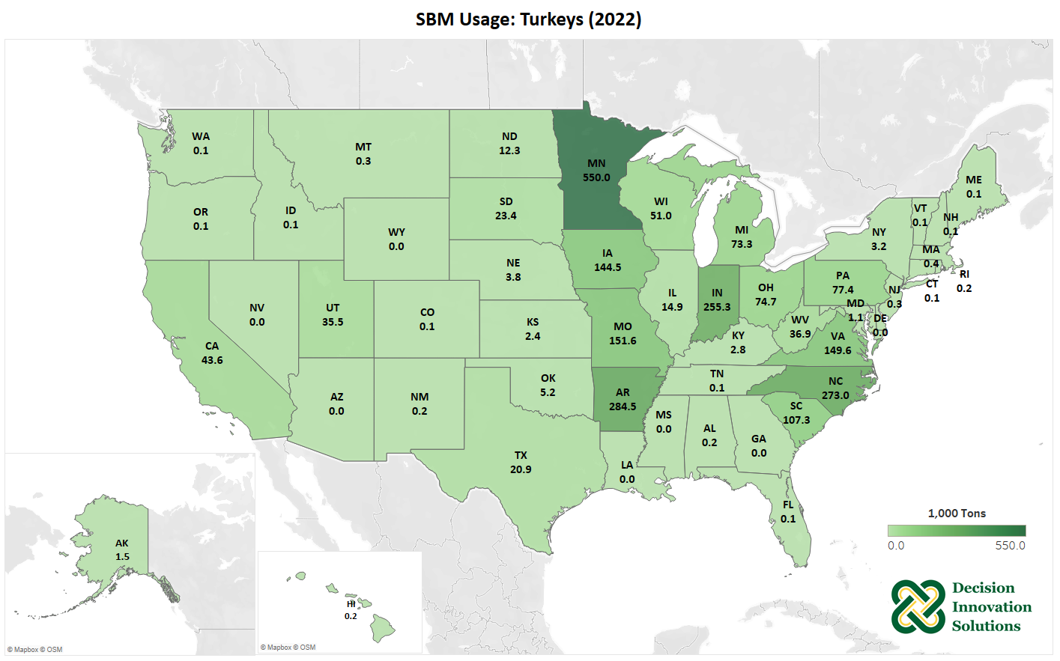
Notes:
Minnesota was the leading state for turkey production and consumed about 549,986 tons of SBM by the state’s turkeys in 2022. Arkansas (284,546 tons), North Carolina (273,019 tons), Indiana (255,280 tons) and Missouri (151,554 tons) turkeys also consumed large amounts of SBM.

Slide 22
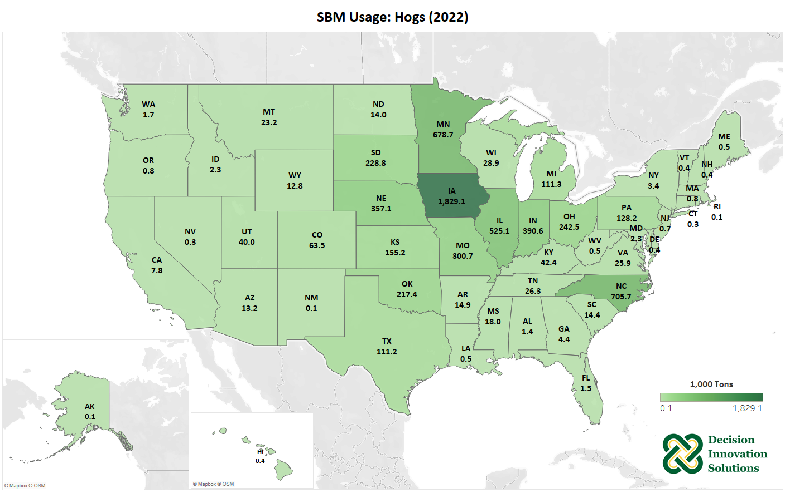
Notes:
Iowa leads the nation in hog production and the state’s hogs consumed 1.8 million tons of SBM in 2022. Hogs in North Carolina (705,693 tons), Minnesota (678,670 tons), and Illinois (525,090 tons) also consumed large amounts of SBM in 2022.

Slide 23
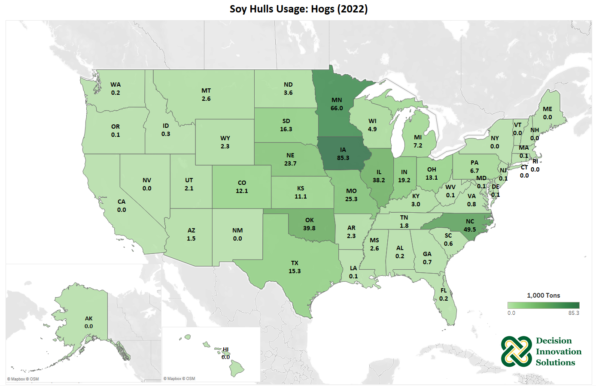
Notes:
In 2022, hogs in Iowa, Minnesota, and North Carolina consumed about 85,337 tons, 66,017 tons, and 49,538 tons of soy hulls, respectively, as the leading states in hog consumption of soy hulls.

Slide 24
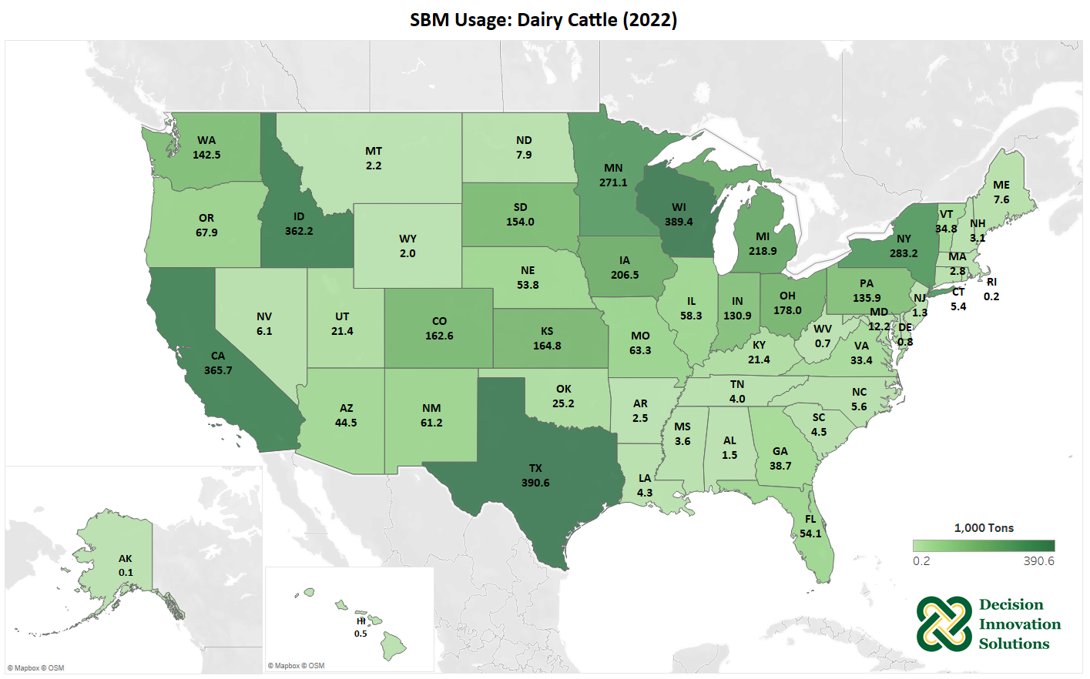
Notes:
In 2022, Texas, Wisconsin, and California dairy cattle consumed about 390,644 tons, 389,369 tons and 365,718 tons of SBM, respectively, as the leading states in dairy cattle consumption of SBM.

Slide 25
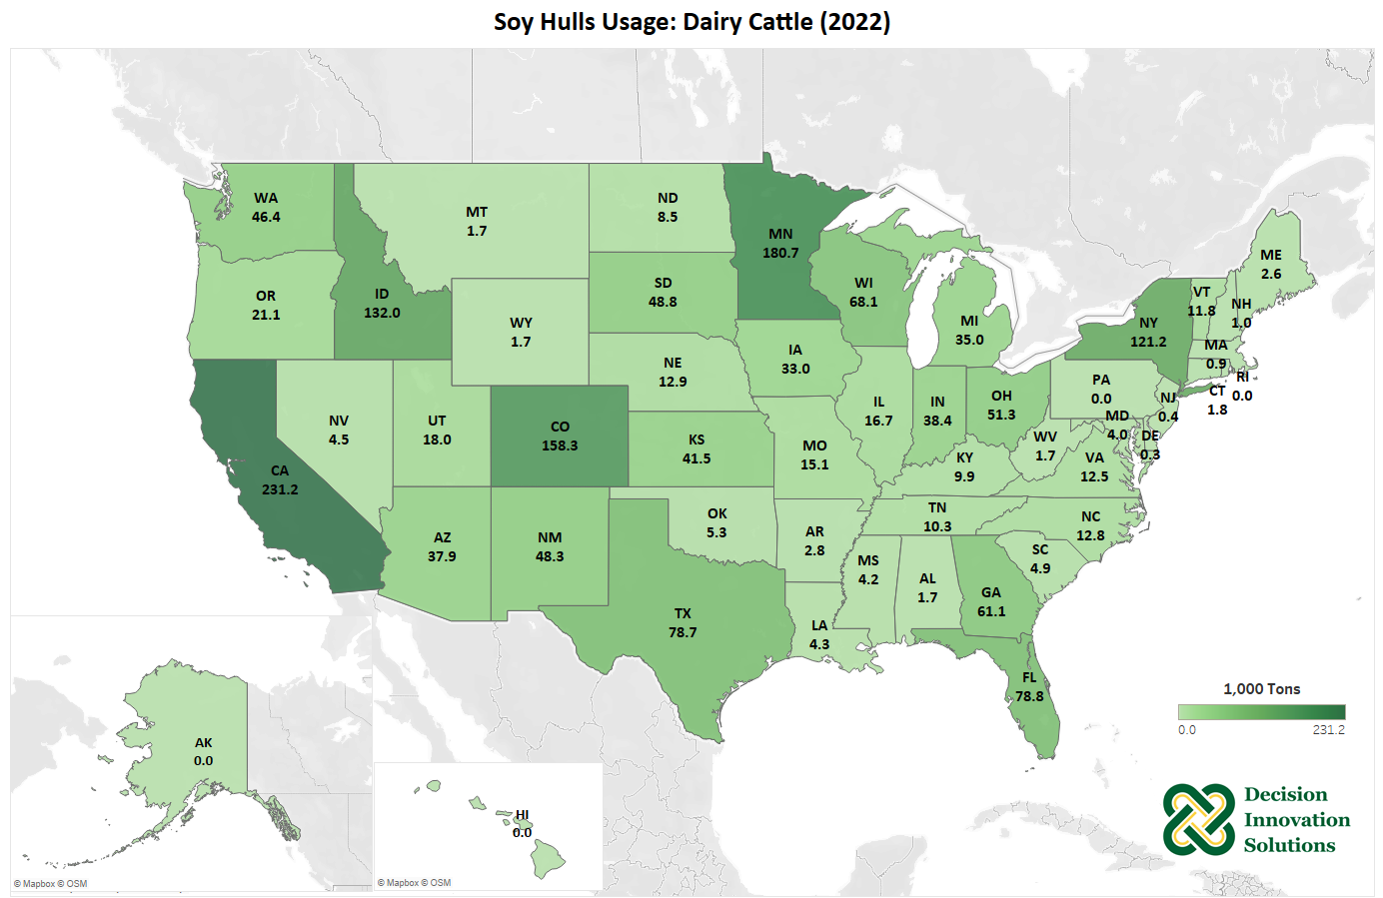
Notes:
Dairy cattle in California, Wisconsin, and Colorado consumed about 231,232 tons, 180,694 tons and 158,332 tons of soy hulls in 2022, respectively, as the leading states in dairy cattle consumption of soy hulls.

Slide 26
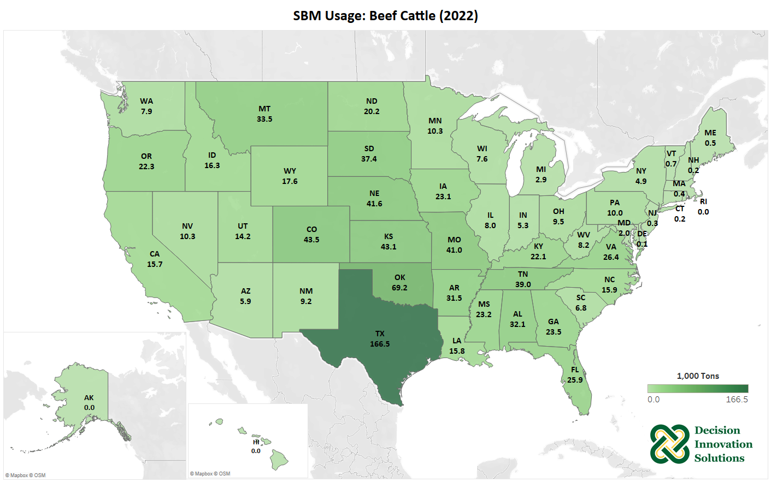
Notes:
Beef cattle in Texas consumed about 166,498 tons of SBM in 2022. Beef cattle in Oklahoma, Colorado, Kansas, Nebraska and Missouri also consumed over 40,000 tons of SBM each in 2022.

Slide 27
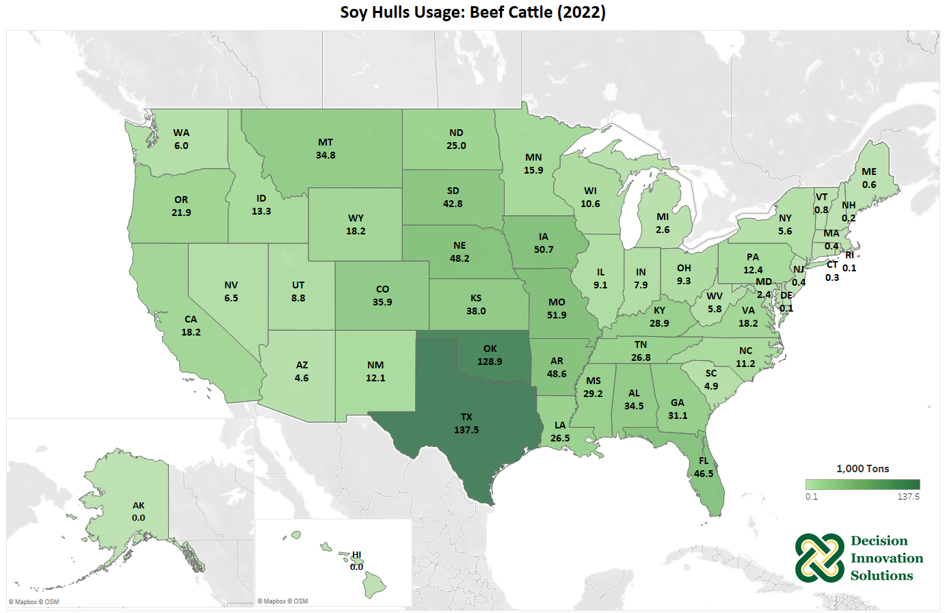
Notes:
Texas beef cattle consumed about 137,458 tons of soy hulls in 2022. Beef cattle in Oklahoma, Missouri, and Iowa also consumed greater than 50,000 tons of soy hulls in 2022.

Slide 28
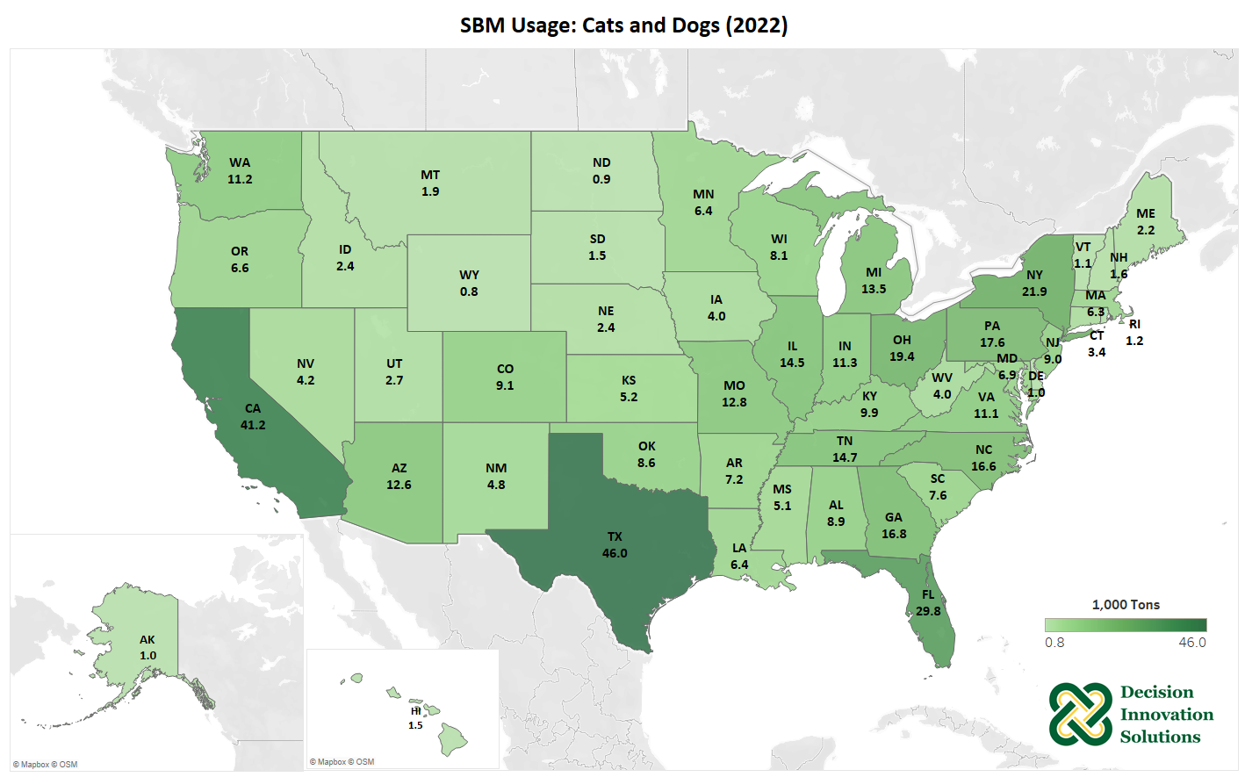
Notes:
The pets considered in this report include cats and dogs. The leading state in SBM usage for pets was Texas with about 45,993 tons in 2022. California and Florida also had significant amounts of SBM usage by pets with about 41,215 and 29,750 tons, respectively in 2022.

Slide 29
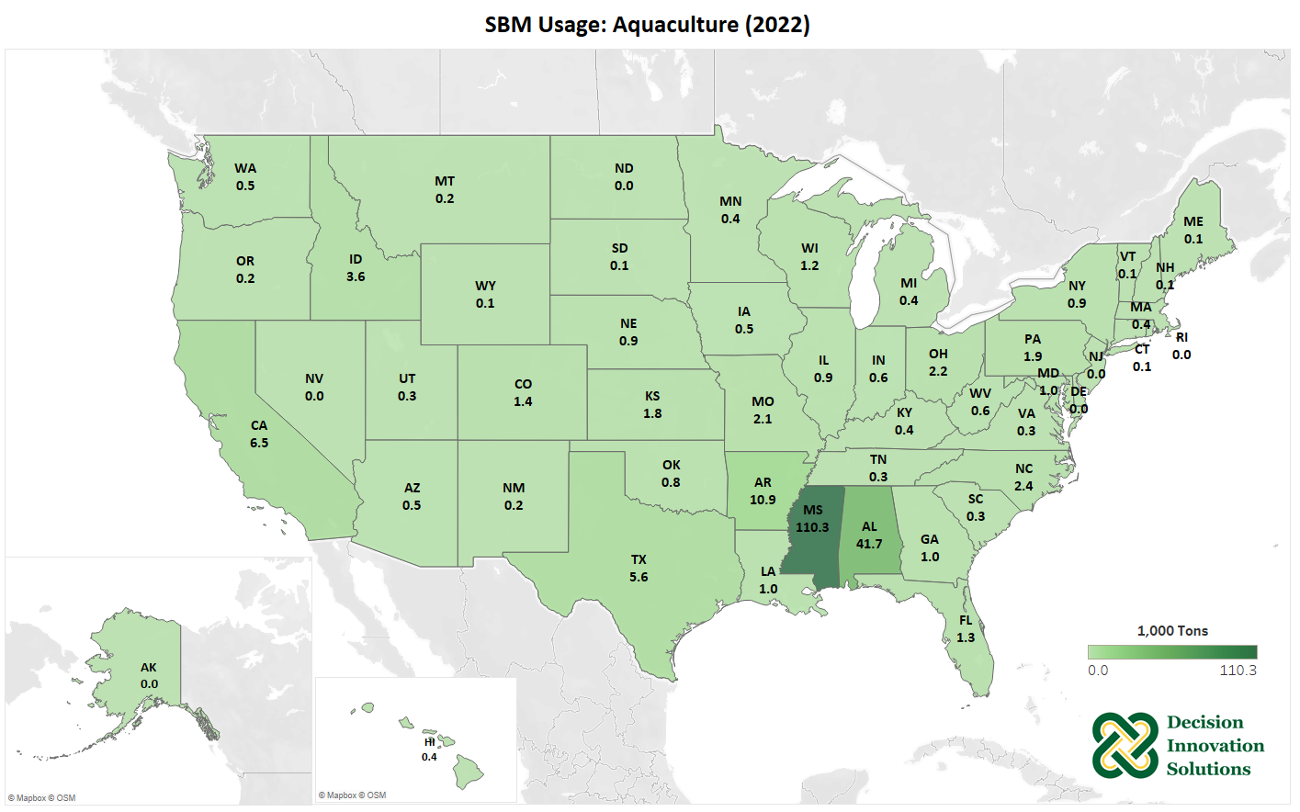
Notes:
This 2022 study includes catfish, trout, tilapia, hybrid striped bass, yellow perch, shrimp, baitfish, and carp in estimates for aquaculture consumption of SBM. Most SBM consumed in the aquaculture category is in Mississippi and Alabama, with about 110,329 and 41,669 tons, respectively in 2022.

Slide 30
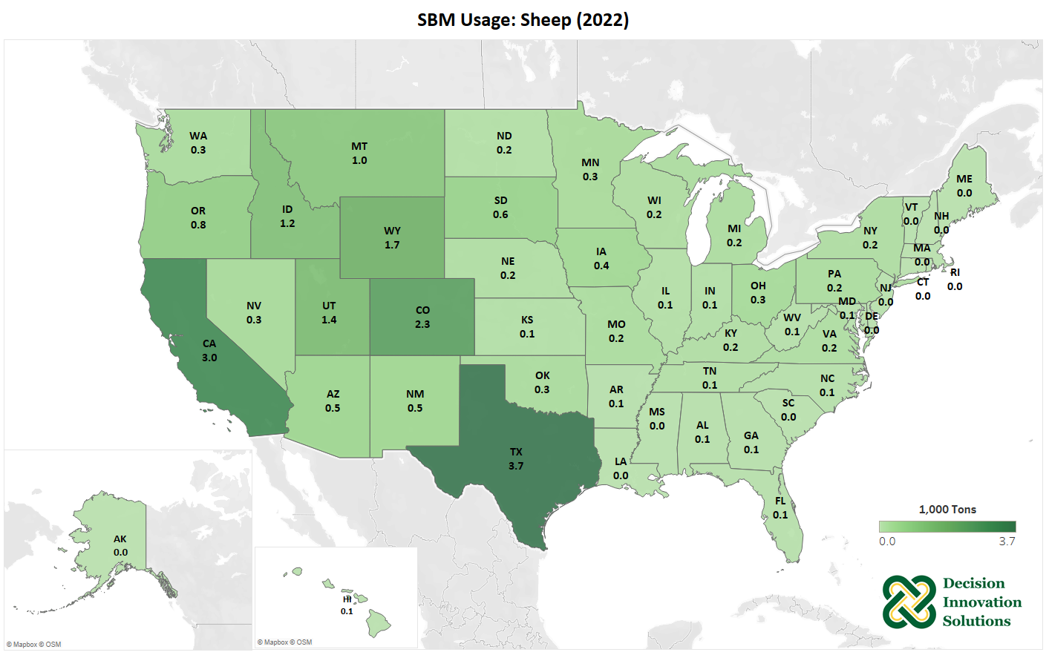
Notes:
Texas was the leading state for SBM usage in sheep production in 2022, with about 3,668 tons, followed by California with 3,034 tons of SBM consumption. Many other states across the West also used between 500 and 1,000 tons of SBM for sheep production.

Slide 31
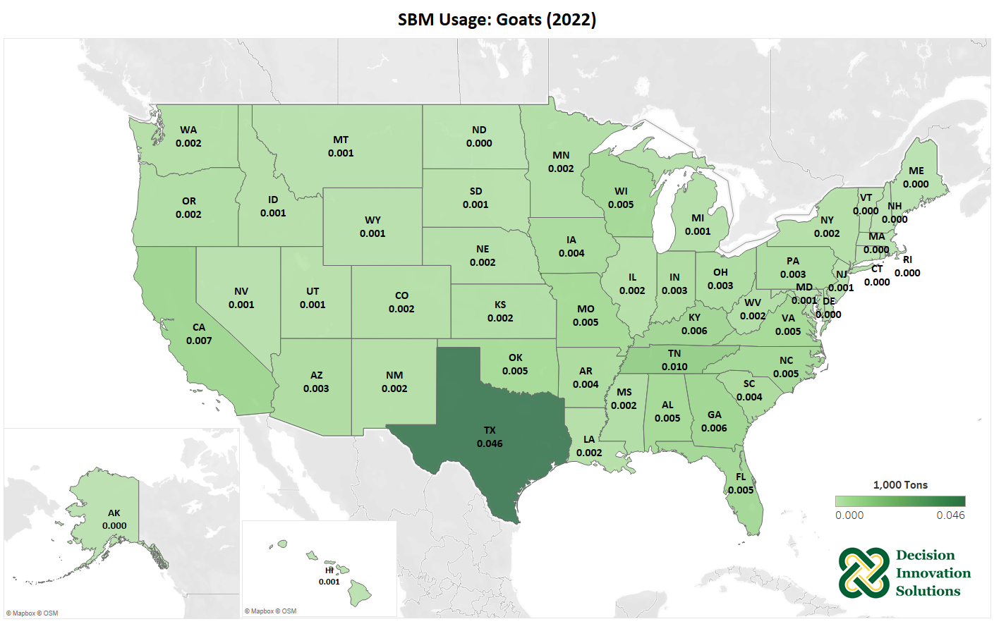
Notes:
Texas had the most SBM usage in goats with about 46 tons in 2022. Overall, SBM usage for meat goats is minimal in most states across the U.S.

Slide 32
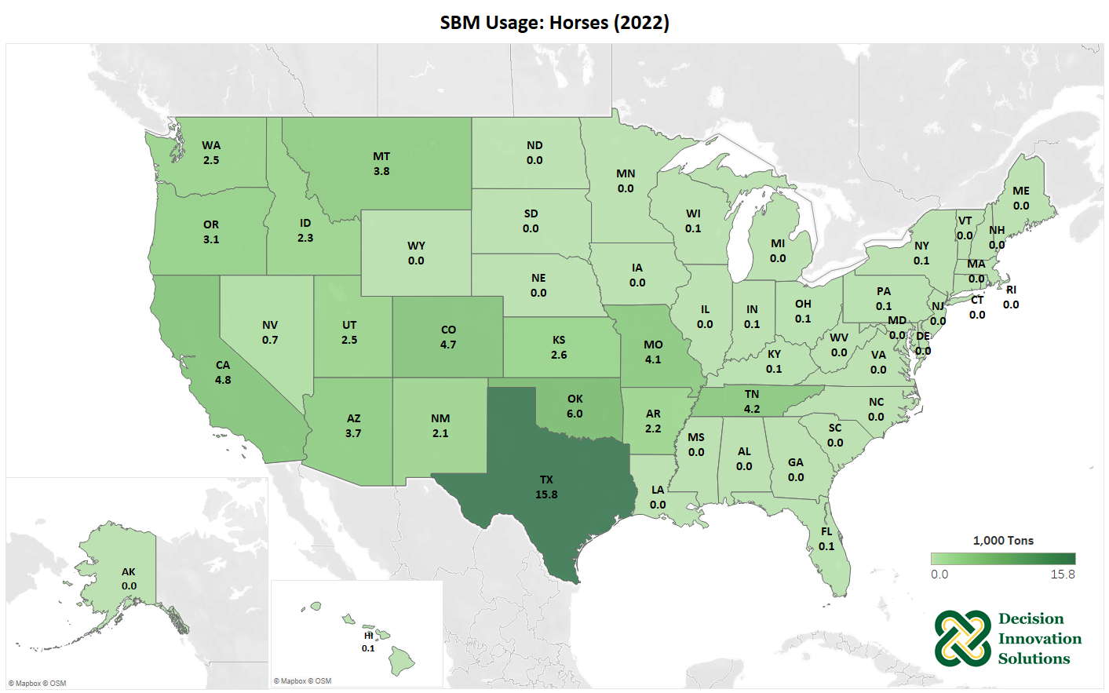
Notes:
Texas was the leading state for SBM usage in horses in 2022, with about 15,835 tons. Horses in Oklahoma, California, Colorado, Tennessee, and Missouri also consumed greater than 4,000 tons of SBM in 2022.

Slide 33
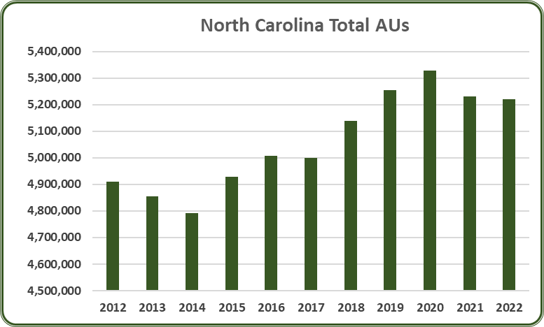
Notes:
In 2022, North Carolina had 5.22 million total AUs, a 0.2% decrease from 2021. From 2012 to 2022, the average number of total AUs in North Carolina was 5.06 million AUs. Since 2012, total AUs in North Carolina have increased by 6.3%.

Slide 34
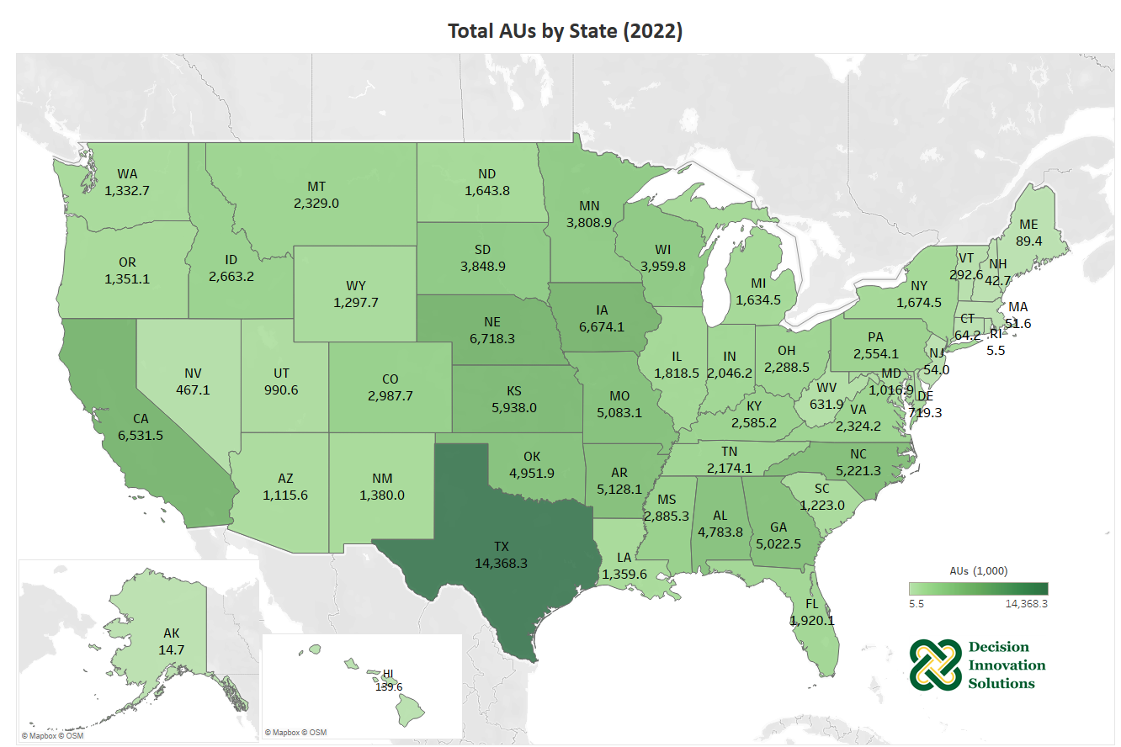
Notes:
The map below represents the combined total number of animal units for all species by state. As shown, Texas was home to almost 15 million animal units in 2021. Nebraska and Iowa follow with 6.7 and 6.6 million AUs, respectively.

Slide 35
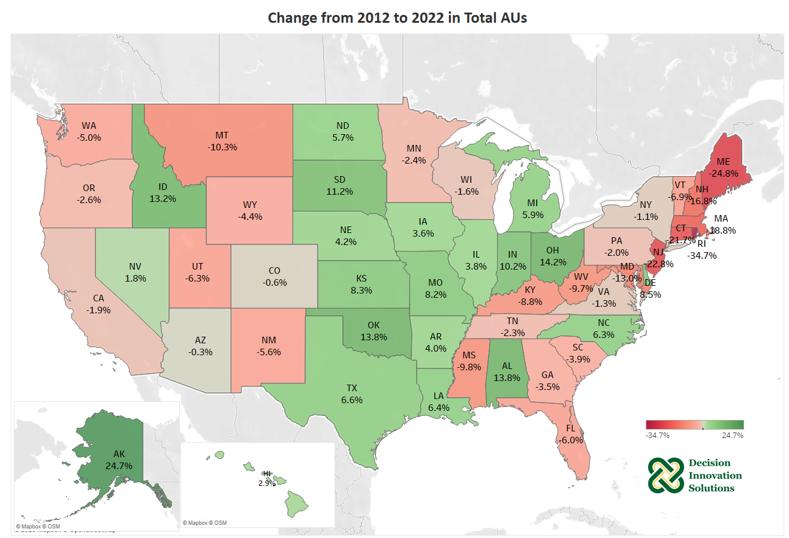
Notes:
States across the eastern and western parts of the U.S. saw declines in total animal units from 2012 to 2022, while many Midwestern states saw increases in animal units. Reduction in cattle and hog production in many eastern and western states and increased production in Midwestern states contributed to changes in animal units. Texas, the leading state in total animal units in 2022, increased by 6.6% from 2012 to 2022, Nebraska increased by 4.2%, and Iowa increased by 3.6%

Slide 36
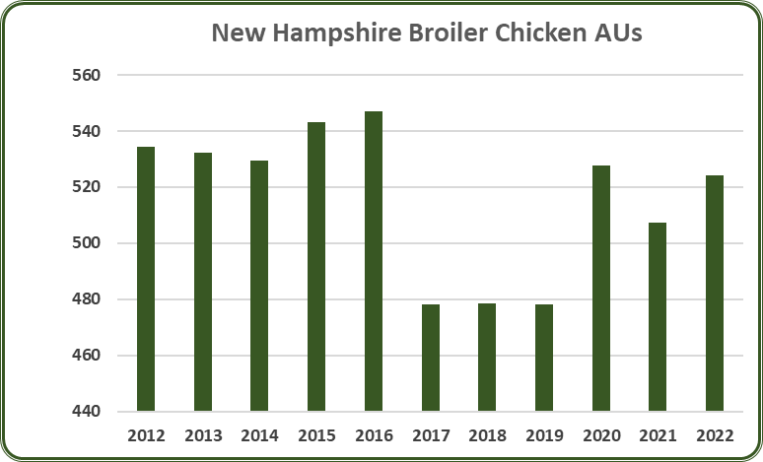
Notes:
In 2022, North Carolina had 2.93 million broiler AUs, a 0.5% increase from 2021. Broilers accounted for 56.1% of the total AUs (5.22 million) in North Carolina. From 2012 to 2022, the average number of broiler AUs in North Carolina was 2.61 million AUs. Since 2012, broiler AUs have increased by 22.1%.

Slide 37
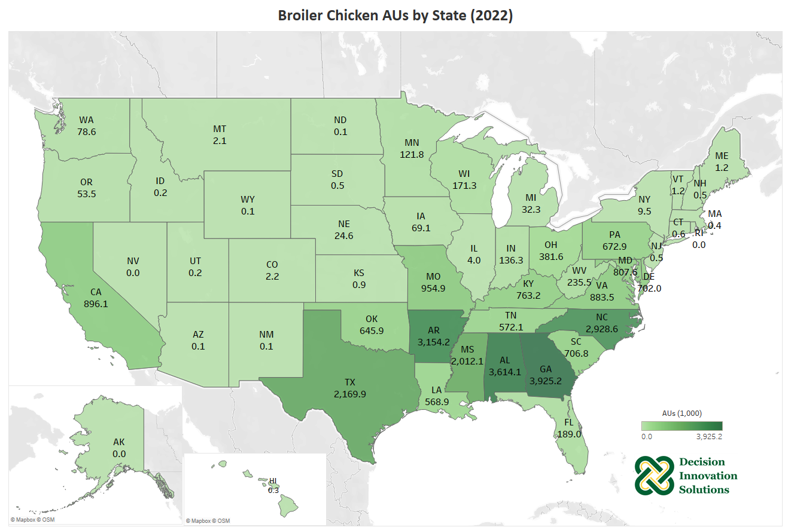
Notes:
U.S. broiler chickens are heavily concentrated in the southeastern states of Georgia, Alabama, Arkansas, North Carolina and Mississippi. In 2022, about 14% of the nation’s broiler chickens were in Georgia, broiler chicken AUs in GA was 3.9 million, while Alabama and Arkansas house 13% (3.6 million AUs) and 11% (3.2 million AUs) of the broiler chickens in the U.S., respectively.

Slide 38
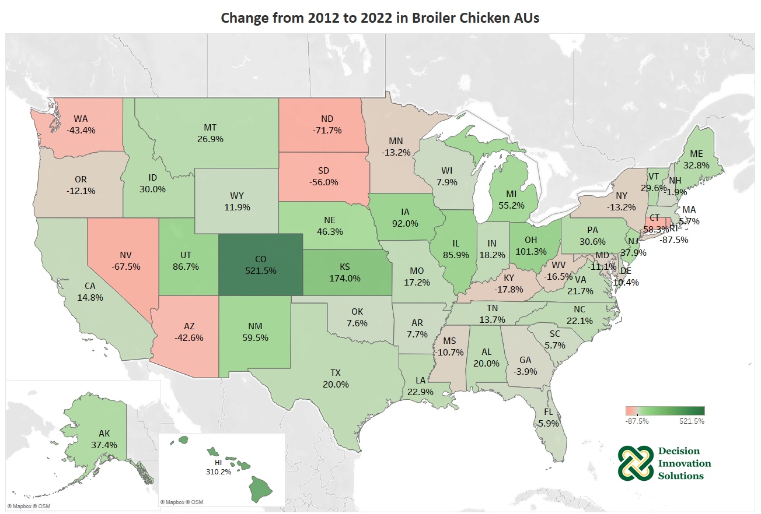
Notes:
This map shows that many states across the West and Midwest saw a large percent changes in broiler chicken animal units from 2011 to 2021, but it is important to remember that these states do not have many broilers. States that have high broiler numbers like Alabama and North Carolina each saw increases of 15% and 23%, respectively, in animal units during the last decade. Alabama and North Carolina accounted for a large increase in total broiler AUs. Massachusetts and Rhode Island had no broiler AUs at the beginning of the ten-year period but began seeing very low broiler AU numbers in 2012.

Slide 39
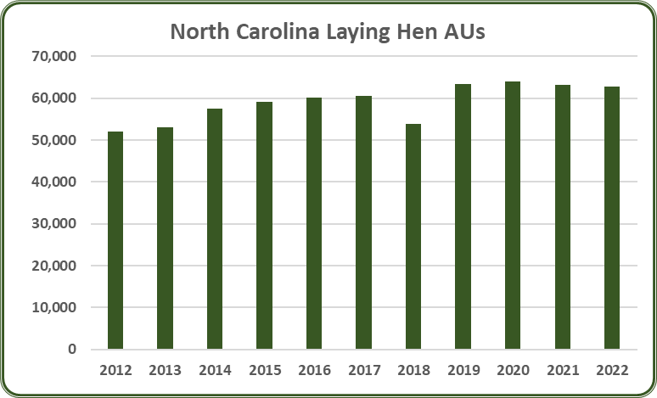
Notes:
In 2022, North Carolina had 62,892 layer AUs, a 0.5% decrease from 2021. Layers accounted for 1.2% of the total AUs (5.22 million) in North Carolina. From 2012 to 2022, the average number of layer AUs in North Carolina was 59,075 AUs. Since 2012, layer AUs have increased by 21.1%.

Slide 40
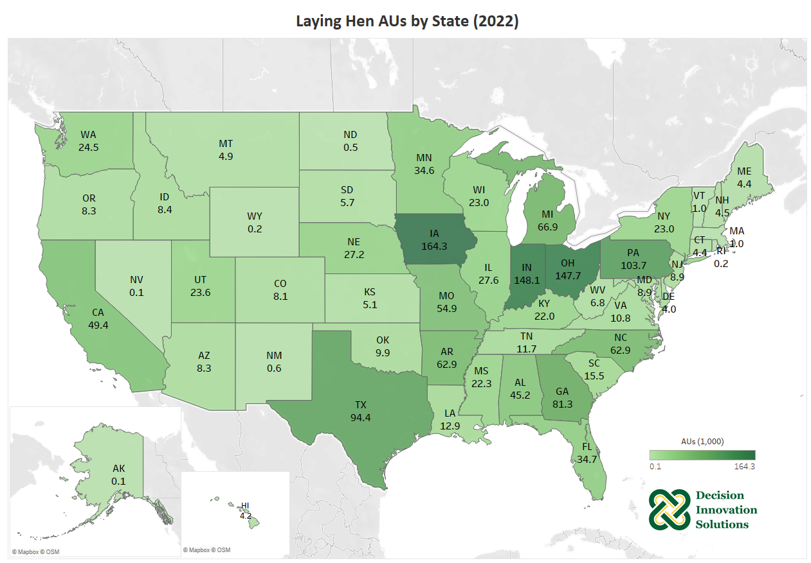
Notes:
Laying hen AUs in Iowa decreased slightly from 2020, but are up from only 150,000 AUs in 2015, which shows recovery in the industry from the losses due to the avian influenza outbreak. Iowa accounts for more than 11% of all laying hen AUs in the U.S. in 2022. Other top states for laying hens include Indiana, Ohio, and Pennsylvania.

Slide 41
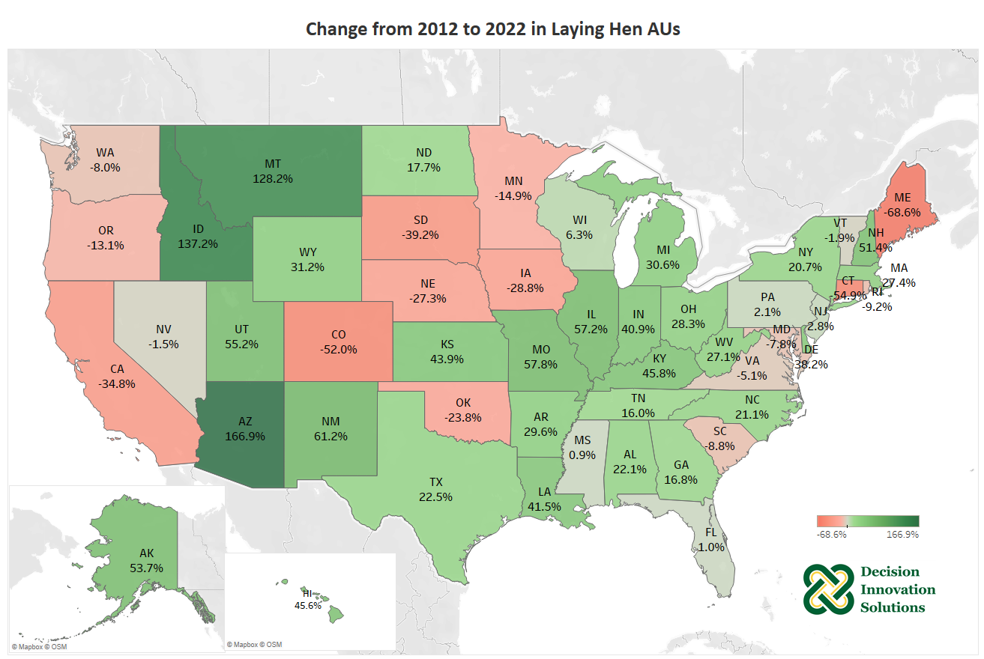
Notes:
Iowa has recovered from the avian influenza losses in 2015 but had a 6.2% increase in laying hen AUs over the last decade. States such as Arizona, Idaho, and Montana saw large percentage increases, but in real terms of animal units those numbers are small.

Slide 42
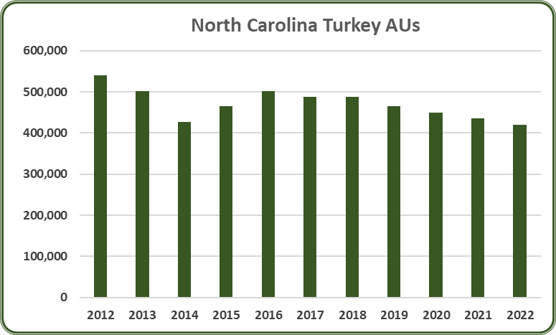
Notes:
In 2022, North Carolina had 420,000 turkey AUs, a 3.4% decrease from 2021. Turkeys accounted for 8% of the total AUs (5.22 million) in North Carolina. From 2012 to 2022, the average number of turkey AUs in North Carolina was 471,136 AUs. Since 2012, turkey AUs have decreased by 22.2%.

Slide 43
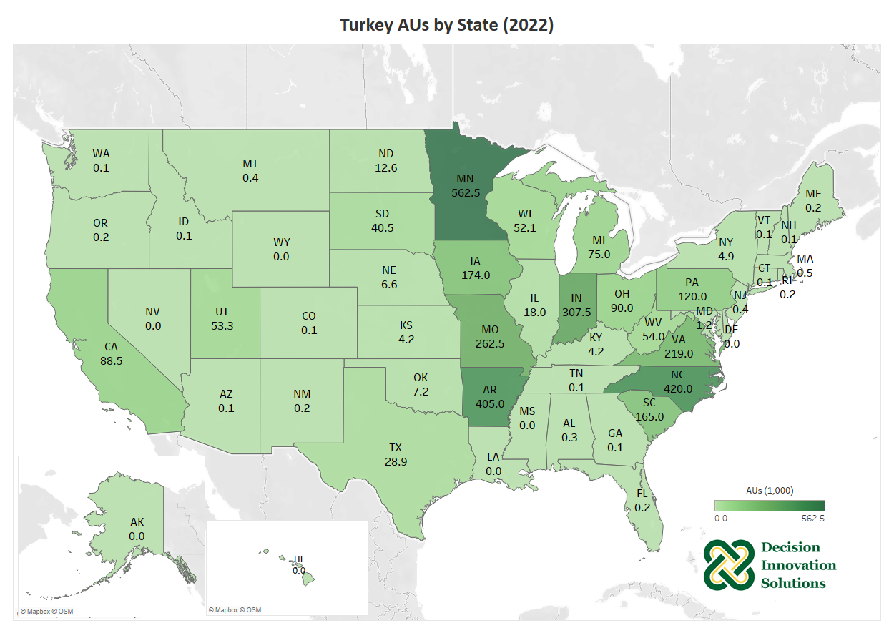
Notes:
In 2022, Minnesota has the highest turkey animal units at 562,500, which was about 18% of the total U.S. turkey animal units. Other top states include North Carolina (13%), Arkansas (13%), Indiana (10%), Missouri (8%), and Virginia (7%).

Slide 44
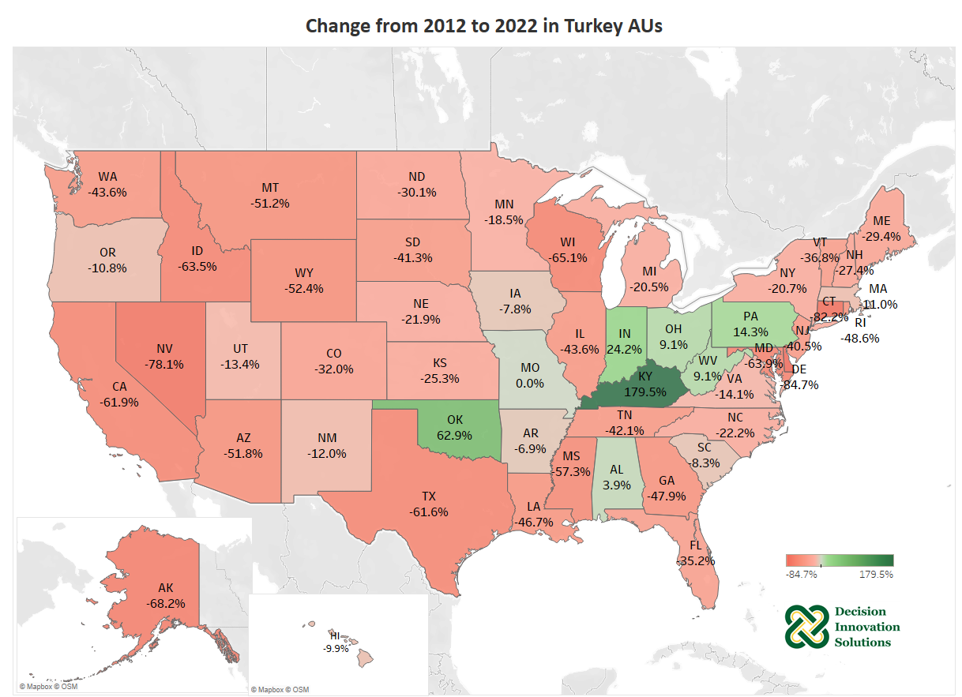
Notes:
A majority of states in the U.S. have seen big decreases over the past decade (decreased over 10%) in turkey AUs. Only 7 states showed an increase during the same period in terms of turkey animal units. Missouri maintained the same in 2022 as in 2012. Kentucky had a 180% increase and Oklahoma had a 62% increase, but in real terms of animal units those numbers are small.

Slide 45
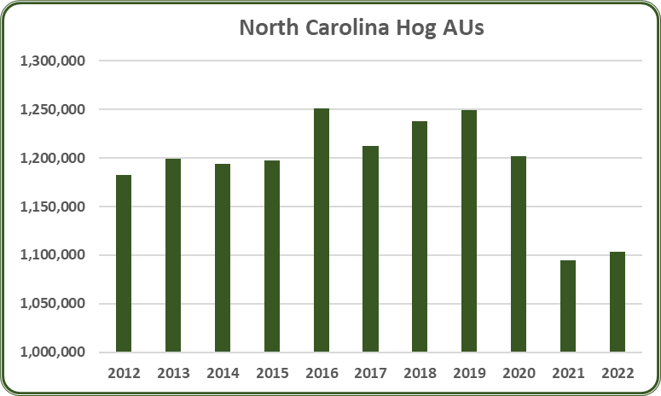
Notes:
In 2022, North Carolina had 1.1 million hog AUs, a 0.8% increase from 2021. Hogs accounted for 21.1% of the total AUs (5.22 million) in North Carolina. From 2012 to 2022, the average number of hog AUs in North Carolina was 1.19 million AUs. Since 2012, hog AUs have decreased by 6.7%.

Slide 46
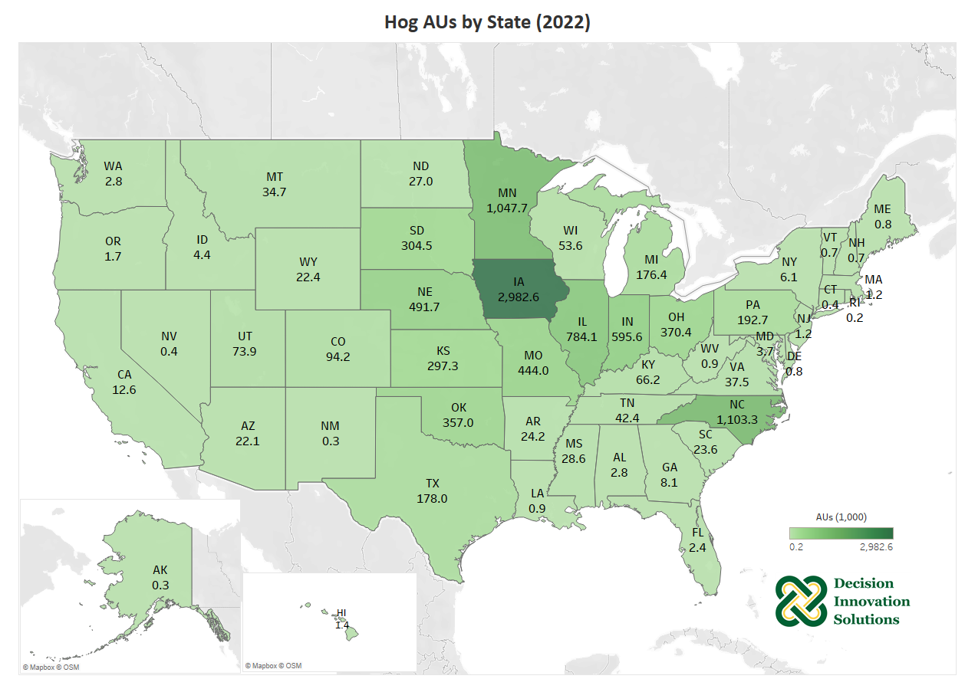
Notes:
Iowa, North Carolina, and Minnesota were the states that housed the most hog animal units in 2022. Iowa accounts for 30% of the nation’s hog animal units while North Carolina and Minnesota each house an additional 11% of total U.S. hog AUs.

Slide 47
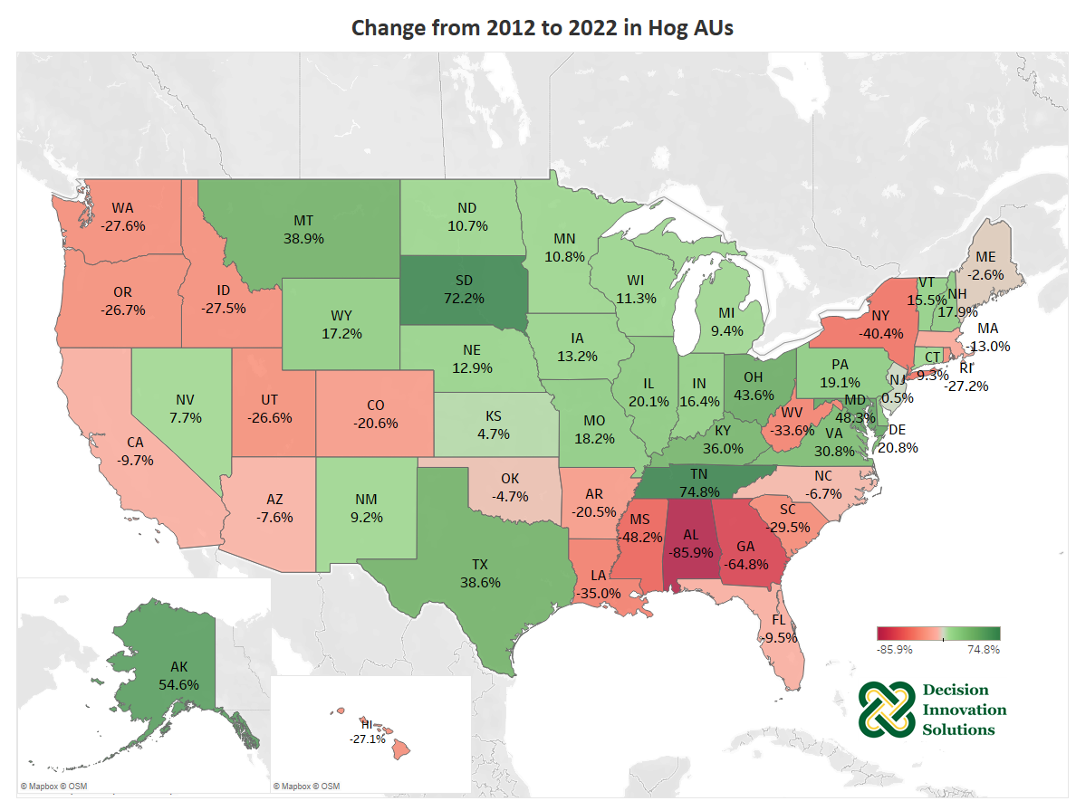
Notes:
Iowa, the leading state in hog production, saw a 13% increase from 2012 to 2022 in hog animal units. However, North Carolina, the second largest state in terms of AUs, decreased about 7% from 2012 to 2022. During the last decade, total U.S. hog AUs have increased 12% due to growing numbers in many Midwestern states.

Slide 48
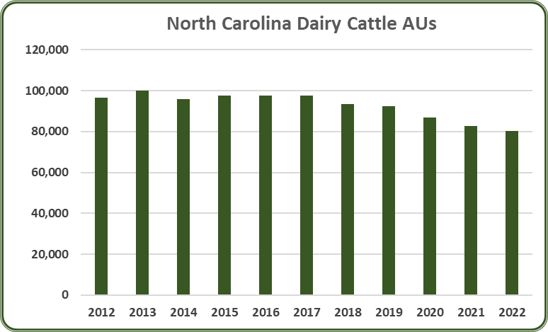
Notes:
In 2022, North Carolina had 80,124 dairy cattle AUs, a 3.2% decrease from 2021. Dairy cattle accounted for 1.5% of the total AUs (5.22 million) in North Carolina. From 2012 to 2022, the average number of dairy cattle AUs in North Carolina was 92,793 AUs. Since 2012, dairy cattle AUs have decreased by 17%.

Slide 49
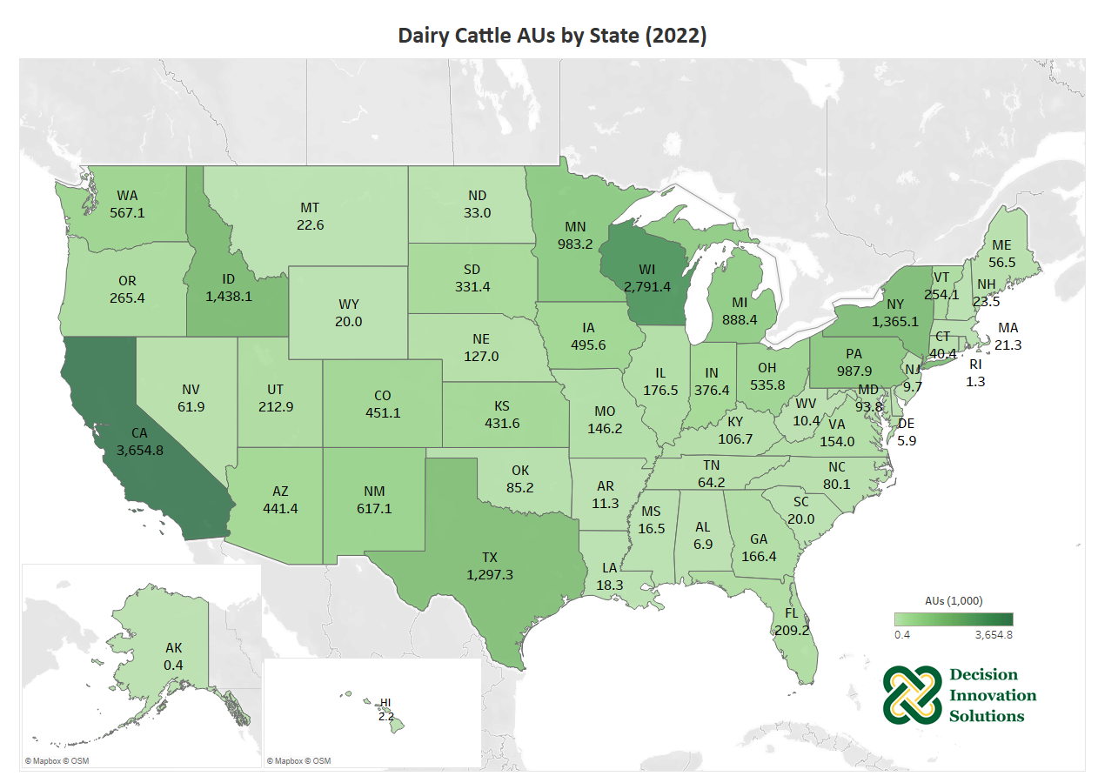
Notes:
California and Wisconsin are the leading states for dairy cattle with nearly 3.7 and 2.8 million animal units, respectively in 2022. Idaho, New York, and Texas also had over 1 million animal units from dairy production in 2022.

Slide 50
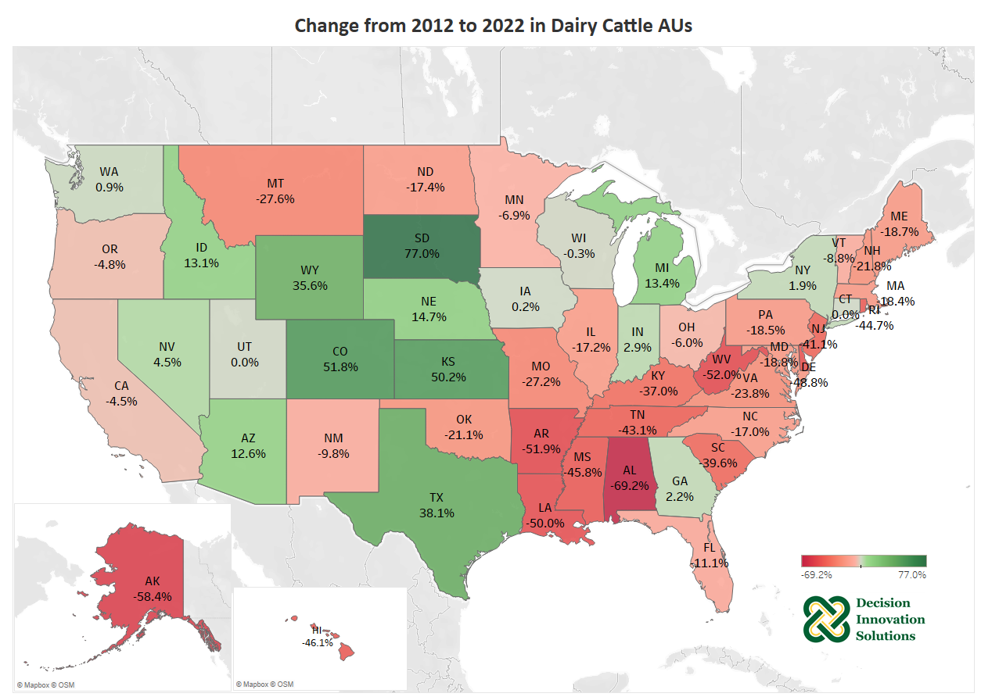
Notes:
Both California and Wisconsin are known for their large dairy cattle population, but California and Wisconsin saw 4.5% and 0.3% decline over the last decade, respectively. During the same period, Texas, Michigan, and Idaho increased their dairy cattle animal units by 38.1%, 13.4% and 13.1%, respectively, and are now among the top 10 states for dairy cattle.

Slide 51
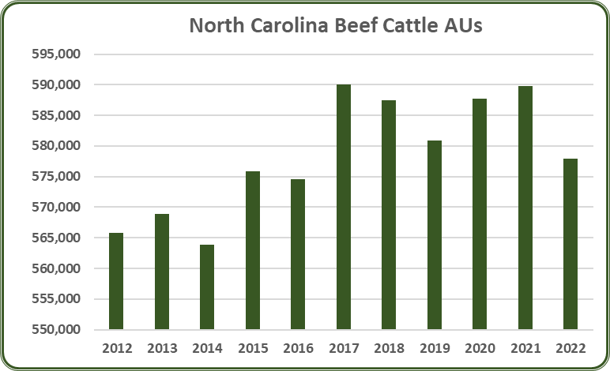
Notes:
In 2022, North Carolina had 577,933 beef cattle AUs, a 2% decrease from 2021. Beef cattle accounted for 11.1% of the total AUs (5.22 million) in North Carolina. From 2012 to 2022, the average number of beef cattle AUs in North Carolina was 578,450 AUs. Since 2012, beef cattle AUs have increased by 2.1%.

Slide 52
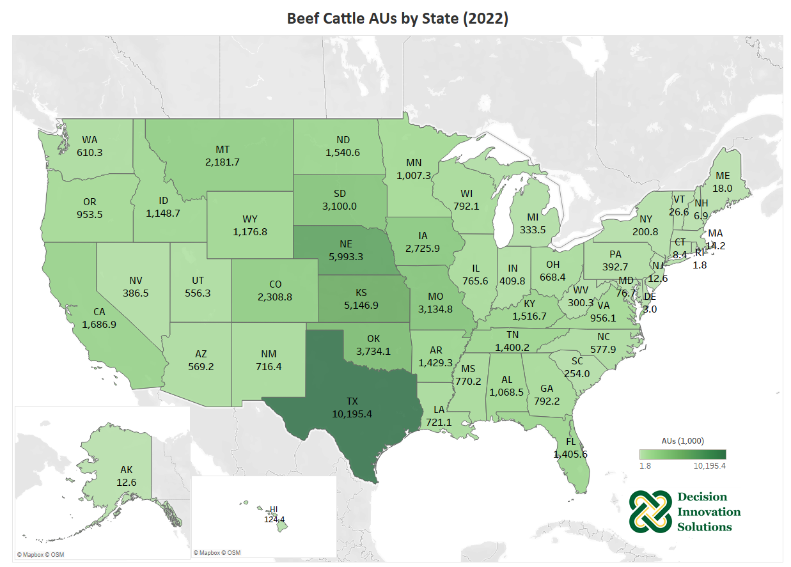
Notes:
Texas, Nebraska, and Kansas are the top three states for beef cattle animal units, with about 10.2, 6.0, and 5.1 million animal units, respectively. In 2022, Oklahoma, Missouri, and South Dakota also exceeded 3 million animal units of beef cattle in 2022.

Slide 53
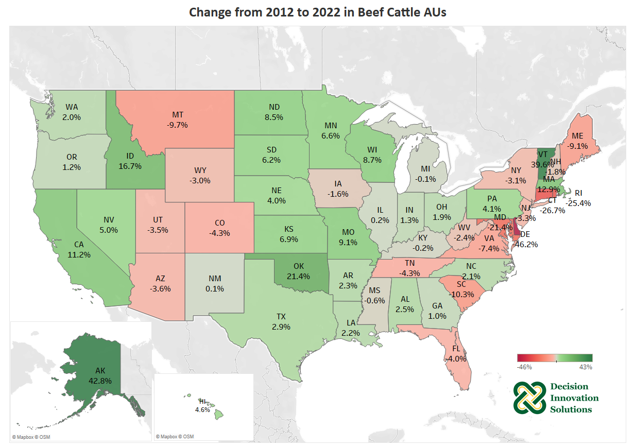
Notes:
The top three beef production states, Texas, Nebraska, and Kansas, all saw increases in beef cattle animal units from 2012 to 2022 in 2.9%, 4.0%, and 6.9%, respectively. Extremely dry periods during 2011-2013 had a significant impact on movement of cattle from states such as Texas and Kansas further north to Nebraska, Missouri, Minnesota, and other states.

Slide 54

Notes:
In 2022, North Carolina had a combined 7,710 sheep, meat goat, and dairy goat AUs, a 3.8% decrease from 2021. These accounted for 0.1% of the total AUs (5.22 million) in North Carolina. Individually, sheep AUs increased 3.7%, meat goat AUs decreased 6.5% and dairy goat AUs decreased 11.8%. Combined there was a 14.4% decrease in sheep and goat AUs since 2012.

Slide 55

Notes:
Sheep and goats account for less than 1% of total U.S. AUs. Texas leads all states in meat goat and sheep production with 13% of total sheep and goat AUs. Other top states include California (10%), Colorado (8%), Wyoming (6%), and Utah (5%). Wisconsin is the top dairy goat producer with 17% of total dairy goat AUs. Texas is the top meat goat producer with 18% of total meat goat AUs.

Slide 56

Notes:
Sheep and goat AUs in the U.S. have declined 5.7% from 2012 to 2022. Only seventeen states had a positive change in AUs. Wisconsin, the leading dairy goat production state, saw a 68.2% increase in dairy goat AUs and a 15.3% increase in both sheep and meat goat AUs. Texas, the leading meat goat production state, saw a 20.0% increase in dairy goat AUs but saw a 1.53% decrease in both sheep and meat goat AUs. States with growth were mostly small producing states like Hawaii and Alaska.

Slide 57

Notes:
In 2022, North Carolina had 40,694 horse AUs, a 5% decrease from 2021. Horses accounted for 0.8% of the total AUs (5.22 million) in North Carolina. From 2012 to 2022, the average number of horse AUs in North Carolina was 52,890 AUs. Since 2012, horse AUs have decreased by 39.1%.

Slide 58

Notes:
Horses account for about 2% of total U.S. AUs. Texas leads all states in horse production with 12% of total horse AUs. Other top states include Oklahoma (4%), Kentucky (4%), California (3%), and Colorado (3%).
AUs for horses is new content added since 2022 for FY21 SBM demand study. Horse AU calculation is only from USDA Census of Agriculture inventory number. Please find out more details under the Methodology section.

Slide 59

Notes:
Horse AUs in the U.S. have declined 38% from 2012 to 2022. Texas, Oklahoma, and Kentucky, the leading three horse production states, saw about 30-40% decrease in horse AUs.

