Slide 1
2021 Economic Analysis of Animal Agriculture
United Soybean Board

Slide 2
Objectives
Economic impact of animal agriculture to local (state) economies from 2010-2020
Soybean Meal (SBM) usage by animal species during the 2019/2020 soybean marketing year
Animal Unit (AU) trends from 2010-2020

Slide 3
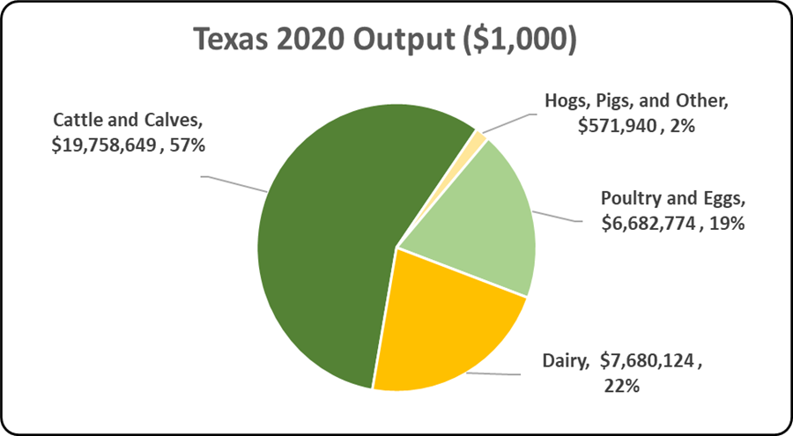
Notes:
The chart illustrates the impact of animal agriculture to the Texas economy. Animal agriculture’s impact on Texas total economic output is about $34.7 billion.

Slide 4
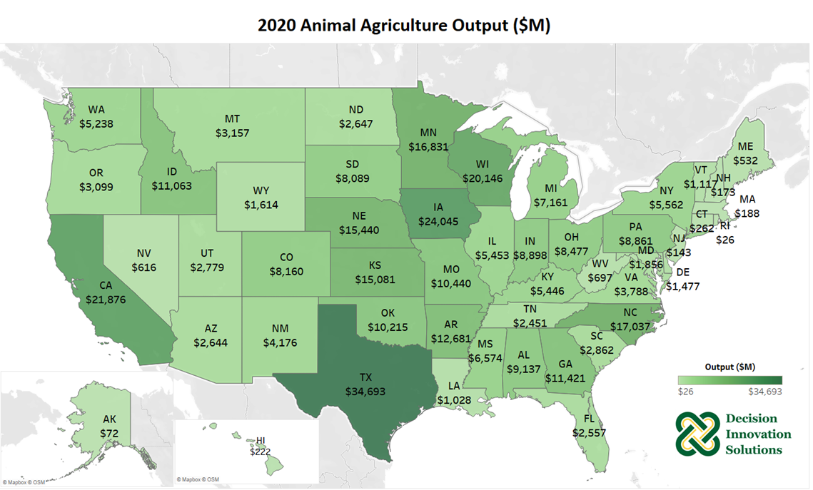
Notes:
Animal agriculture is an important piece to the U.S. economy, and helped generate $348.2 billion of output in 2020. The top 5 leading states for animal agriculture in terms of output include Texas ($34.7 billion), Iowa ($24.0 billion), California ($21.9 billion), Wisconsin ($20.1 billion), and North Carolina ($17.0 billion).

Slide 5
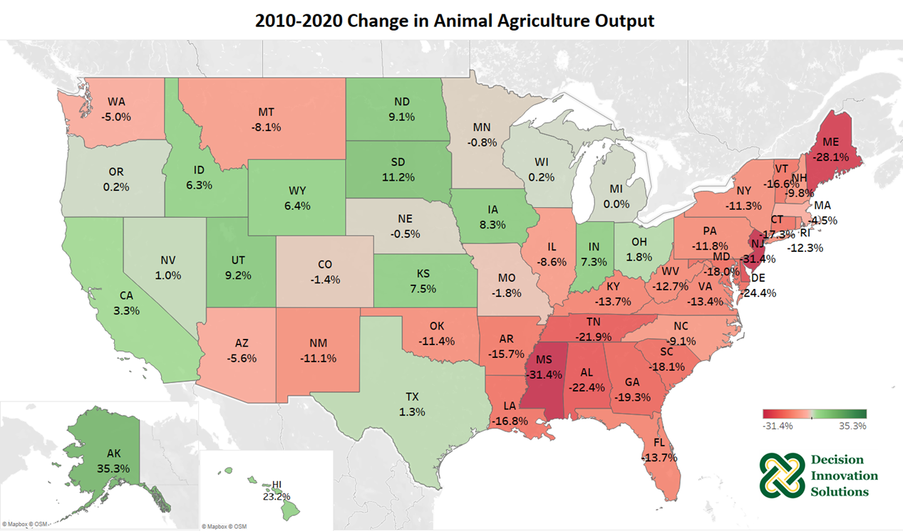
Notes:
The majority of states across the U.S. saw a decrease from 2010 to 2020 in the amount of output supported by animal agriculture, especially on the east coast. Alaska, Hawaii, South Dakota, Utah and North Dakota were the leading states for total dollar increases in animal agriculture output, though the total animal agriculture output in these states is relatively small. Four out of the five leading states in the total animal agriculture output saw a small increase from 2010 to 2020, i.e., Texas 1.3% increase, Iowa 8.3% increase, California 3.3% increase, and Wisconsin 0.15% increase.

Slide 6
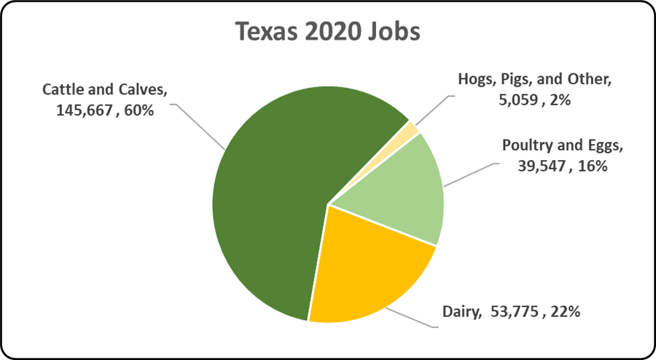
Notes:
The chart illustrates the contribution to Texas in terms of animal agriculture jobs. As shown, animal agriculture contributes significantly to Texas total jobs, contributing 244,047 jobs within and outside of animal agriculture.

Slide 7
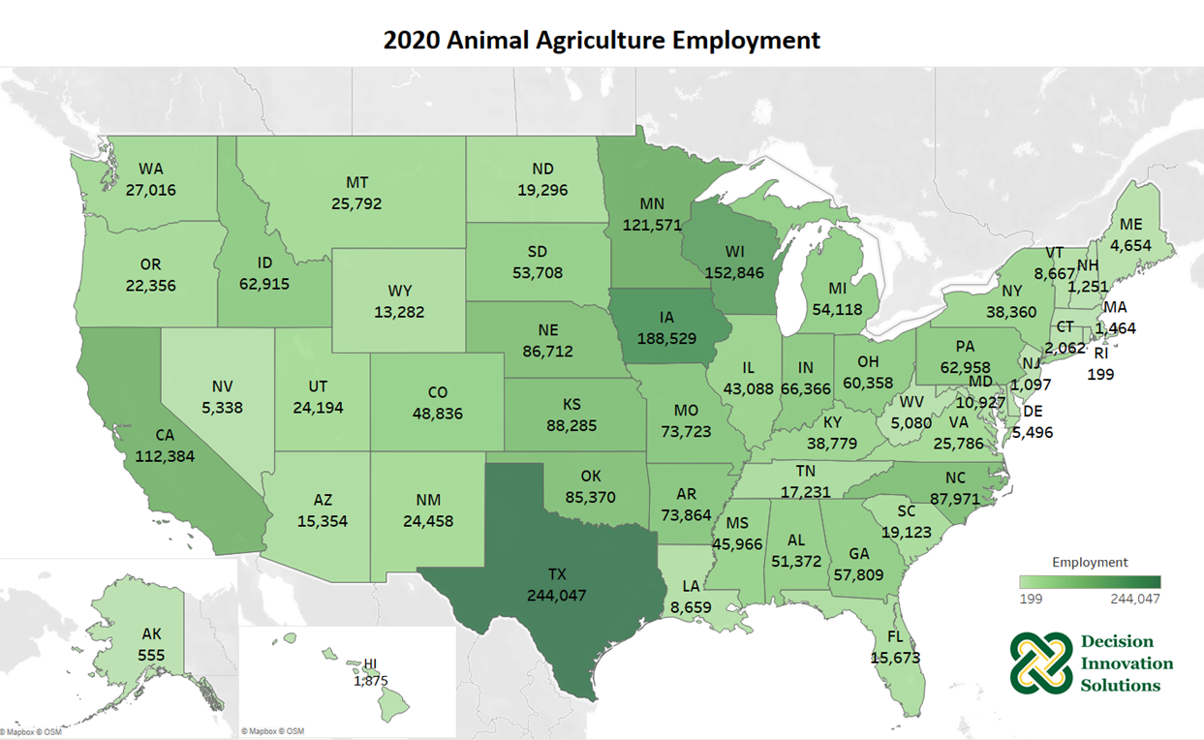
Notes:
In 2020, animal agriculture supported 2,306,818 jobs in the United States. There are five states where this sector is especially robust and supports over 100,000 jobs: Texas (244,047), Iowa (188,529), Wisconsin (152,846), Minnesota (121,571), and California (112,384).

Slide 8
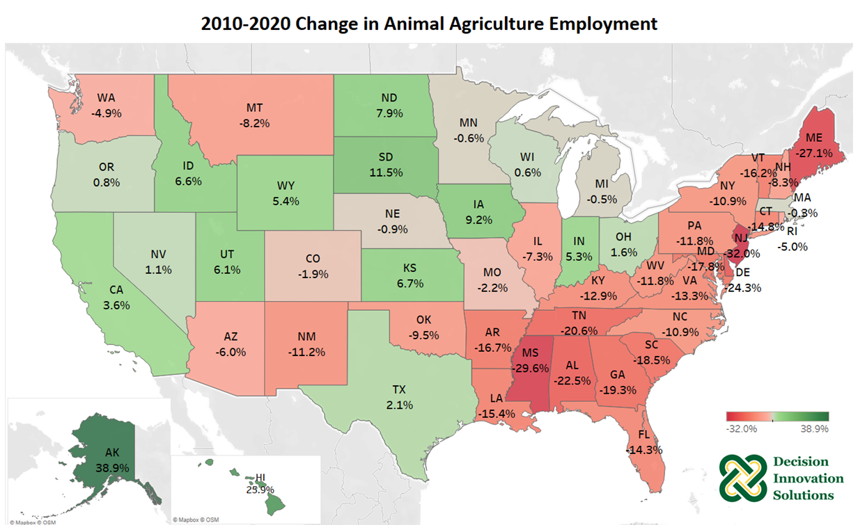
Notes:
Animal agriculture supported increases in jobs in many Midwest and West coast states over the past decade. But the jobs in East coast states have seen a decrease from 2010 to 2020.

Slide 9
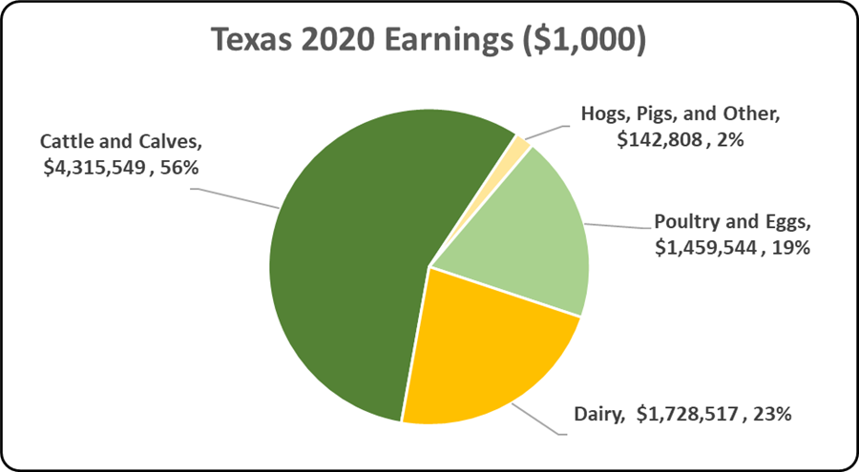
Notes:
The chart illustrates the impact of animal agriculture to the Texas economy in terms of earnings. Texas’s animal agriculture contributed about $7.6 billion to household earnings in 2020.

Slide 10
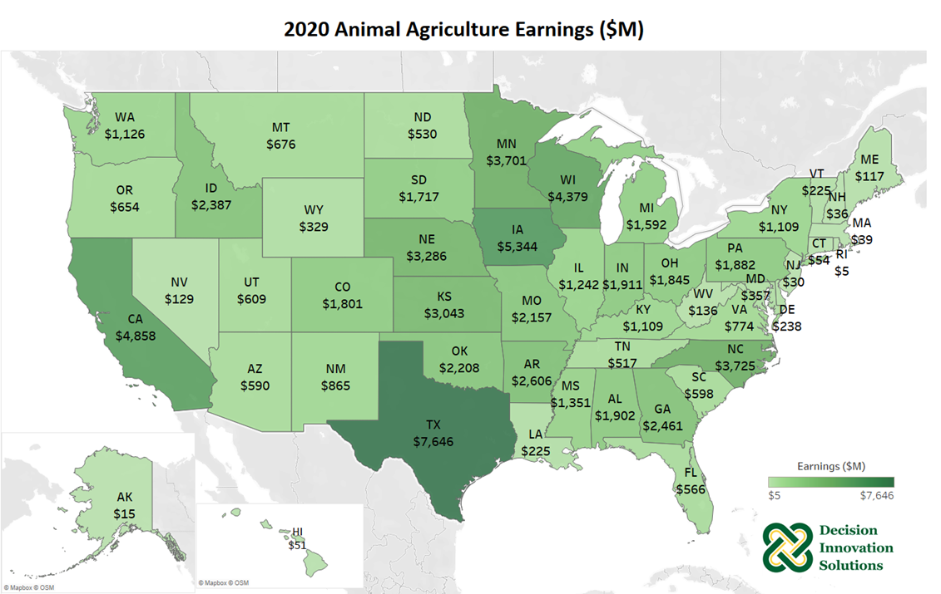
Notes:
Earnings are an important component of a local economy since they allow households to invest capital and spend currency that trades hands many times, generating additional economic activity. Animal agriculture helped generate nearly $74.8 billion in household earnings in the U.S. in 2020 and contributes heavily to earnings in many states such as Texas ($7.6 billion), Iowa ($5.3 billion), California ($4.9 billion), Wisconsin ($4.4 billion), North Carolina ($3.7 billion), and many more.

Slide 11
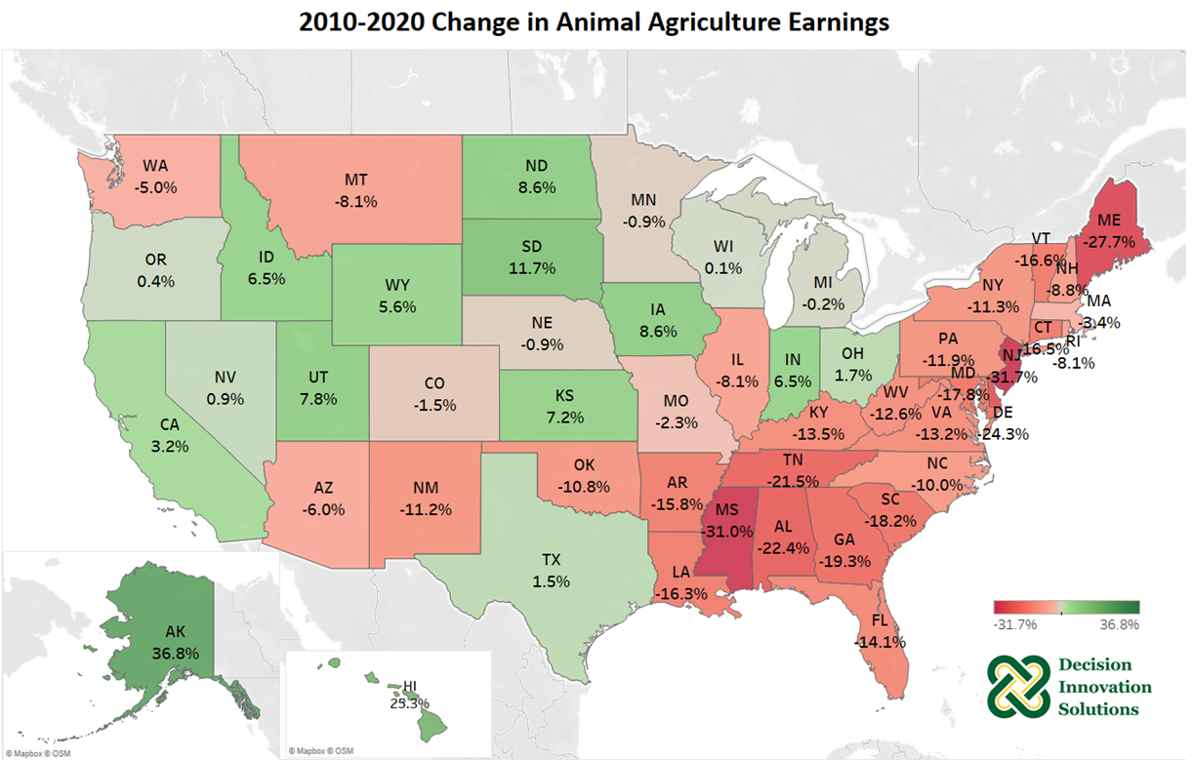
Notes:
Many east coast states have seen decreased earnings, while many states from Midwest and west coast have seen increase earnings, generated from the animal agriculture sector from 2010 to 2020. The animal agriculture sector increased earnings by greater than 5% in 10 states over the past decade, leading by Alaska, Hawaii, South Dakota, Iowa and North Dakota.

Slide 12
Texas Animal Agriculture Multipliers
Notes:
Multipliers are generally stated in the form of “per million dollars” of output. As it relates to this analysis, multipliers are stated as the activity related to every million dollars of economic output in animal agriculture. Referring to the multipliers below, for every million dollars in output generated by the various segments of animal agriculture in Texas, $1.86 to $3.06 million in total economic activity, $0.47 to $0.67 million in household wages and 17 to 20 additional jobs are generated in the economy at large.

Slide 13
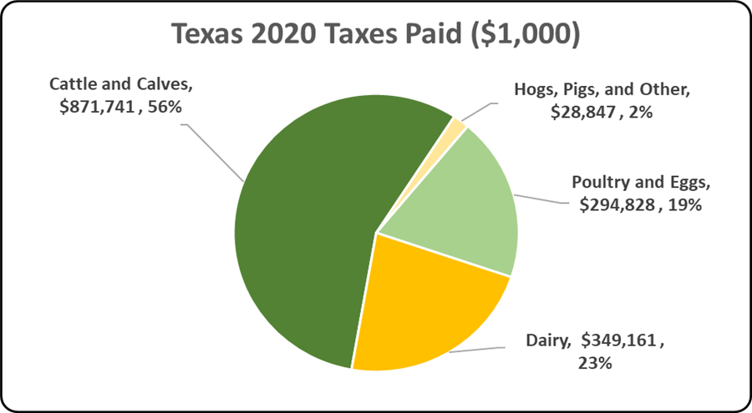
Notes:
In 2020, the state’s animal agriculture industry paid about $1.5 billion in income taxes at local, state, and federal levels. Plus, the 2017 Census of Agriculture estimated $698.2 million in property taxes paid by all of Texas agriculture during 2017.

Slide 14
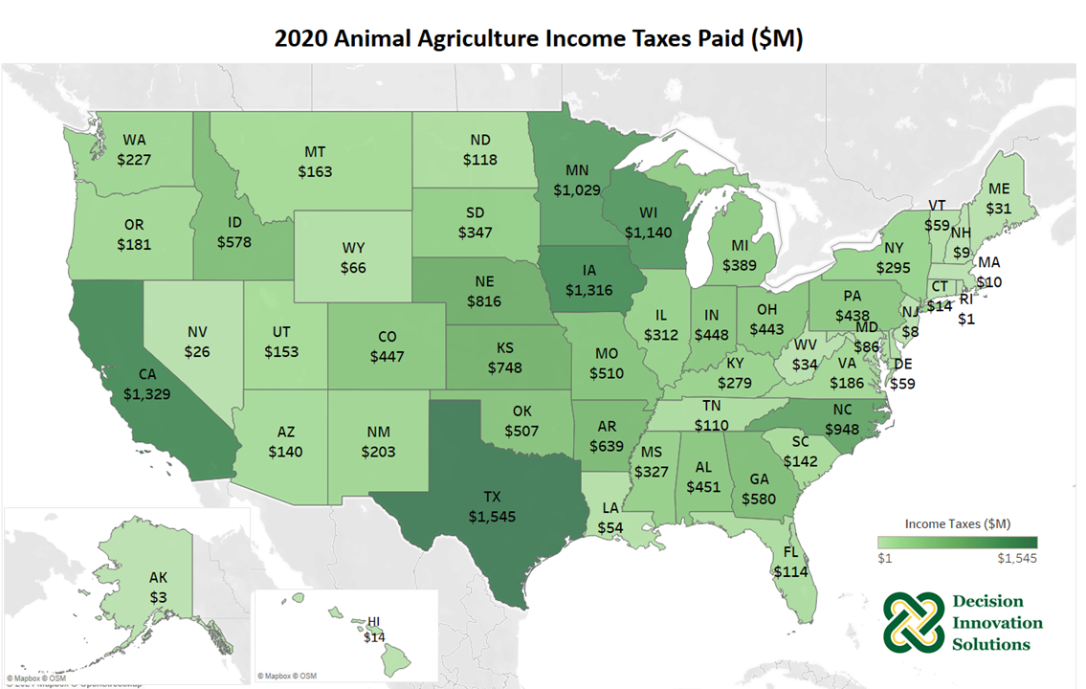
Notes:
In addition to the large amounts of economic activity derived from animal agriculture across the country, animal agriculture plays an important part in supporting local, state and federal taxing jurisdictions. A direct relationship to the size and scope of animal agriculture yields significant income tax payments in states such as Texas, California, Iowa, Wisconsin, and Minnesota. In eighteen states, animal agriculture paid taxes estimated at $400 million or more in 2020.

Slide 15
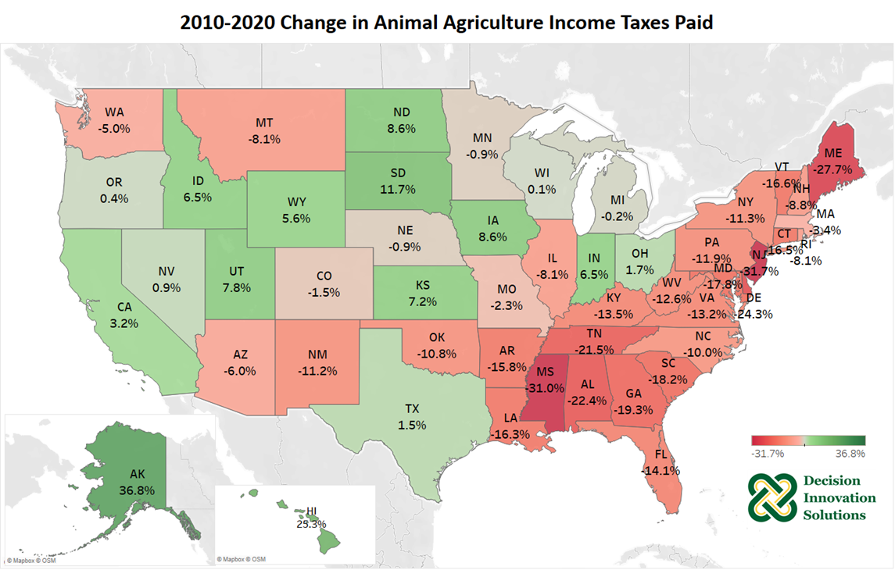
Notes:
Income taxes paid at the local, state, and federal jurisdictions increased steadily over the last decade. States such as Alaska, Hawaii, South Dakota, Iowa and North Dakota, were among top states for total dollar growth in estimated income tax payments. Only three states saw growth over 10% in income taxes paid by animal agriculture from 2010 to 2020, and sixteen states saw an increase over the past decade.

Slide 16
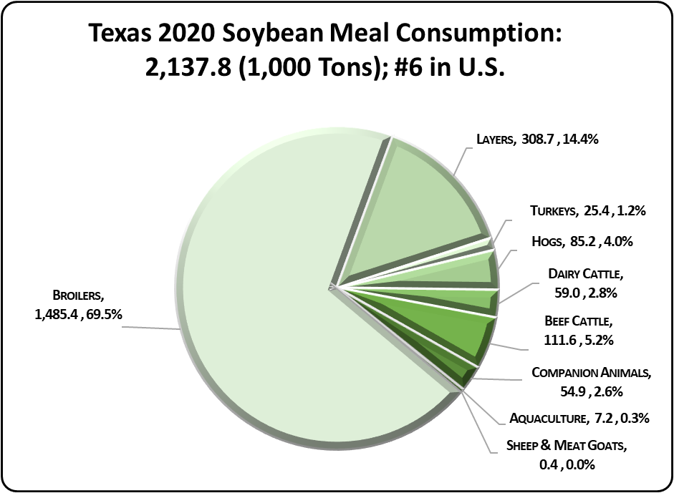
Notes:
Texas’s animal agriculture consumed almost 2.1 million tons of soybean meal in 2020, placing the state as 6 in the nation in terms of soybean meal consumption. Additionally, animal agriculture in Texas consumed 252.0 thousand tons in soy hulls. The three segments of animal agriculture that led the state in estimated soybean meal consumption are:
Broilers (1.5 million tons)
Egg-Laying Hens (308.7 thousand tons)
Beef Cattle (111.6 thousand tons)

Slide 17
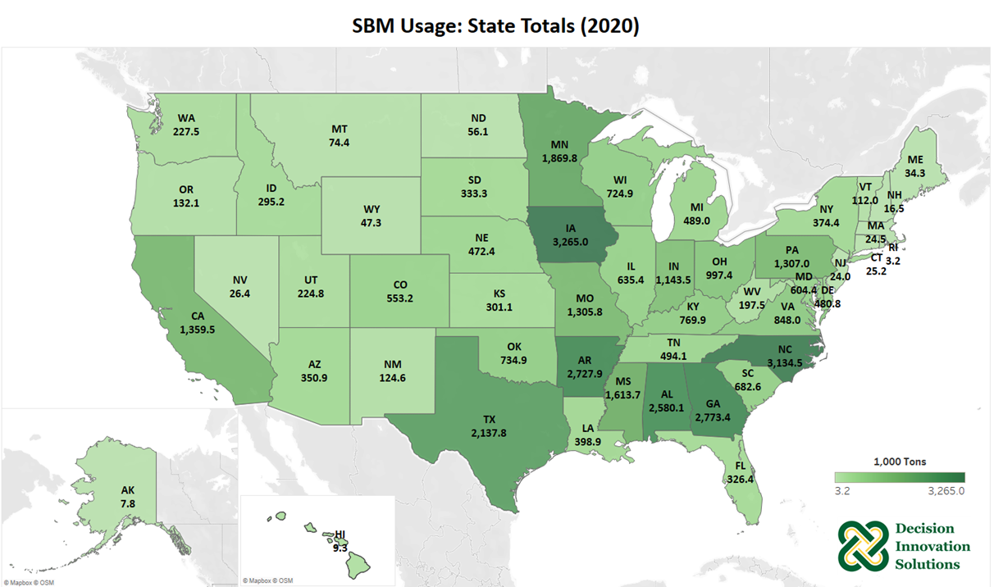
Notes:
Due to the relatively large number of hogs and layers, Iowa was the leader in soybean meal usage for 2020. Other states that used large amounts of soybean meal include North Carolina, Georgia, Arkansas, Alabama, Texas, and Minnesota due to large numbers of animals in those states.

Slide 18
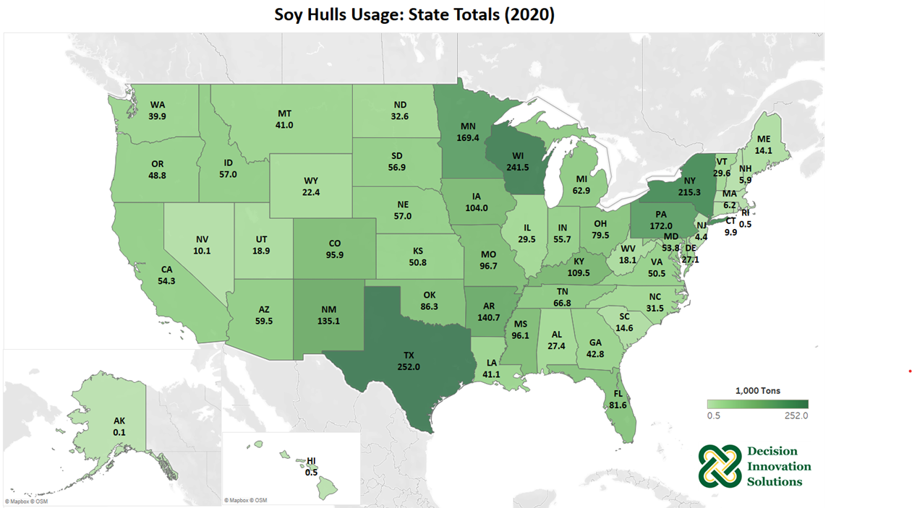
Notes:
Texas was the leading state for soy hulls usage since it is often used in beef cattle ration with nearly 251,999 tons consumed in 2020. Wisconsin and New York also consumed large amounts of soy hulls as the second and third largest state user respectively since it is also used in dairy cattle ration.

Slide 19
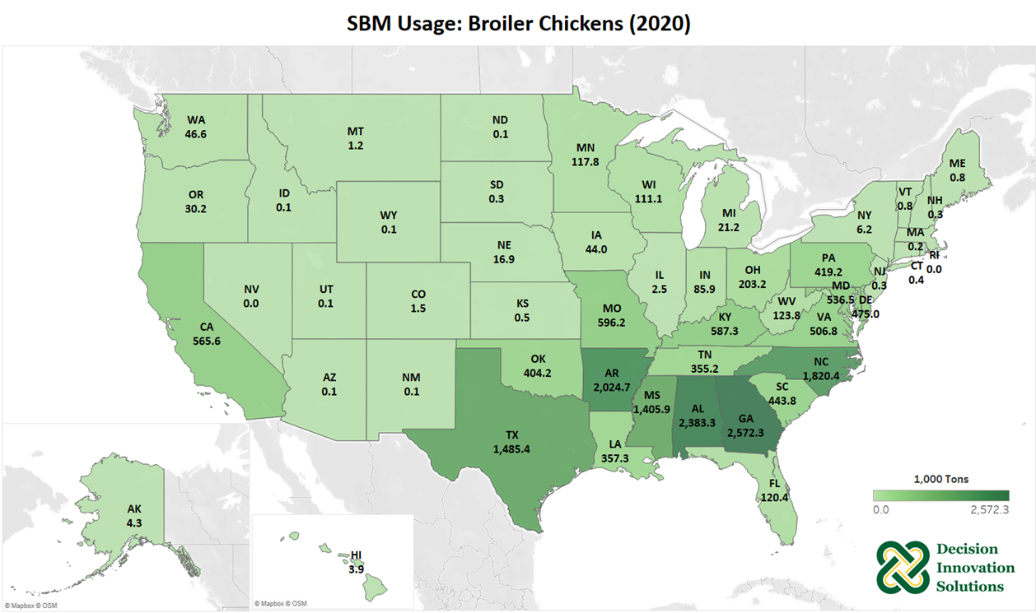
Notes:
Georgia’s broiler chickens consumed about 2.6 million tons of soybean meal in 2020. Other states that use significant amounts of soybean meal in their broiler diets are concentrated in the southeastern states including Alabama, Arkansas, North Carolina, Texas, and Mississippi.

Slide 20
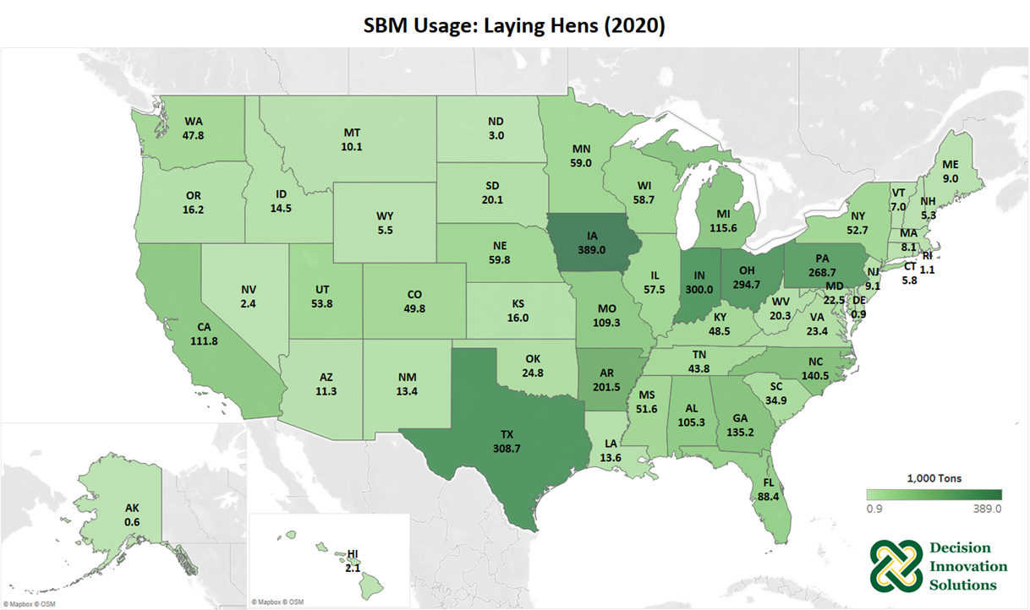
Notes:
In 2020, Iowa’s laying hens consumed about 389,032 tons of soybean meal. Other top states for soybean meal consumption by laying hens in 2020 include Texas, Indiana, Ohio, and Pennsylvania.

Slide 21
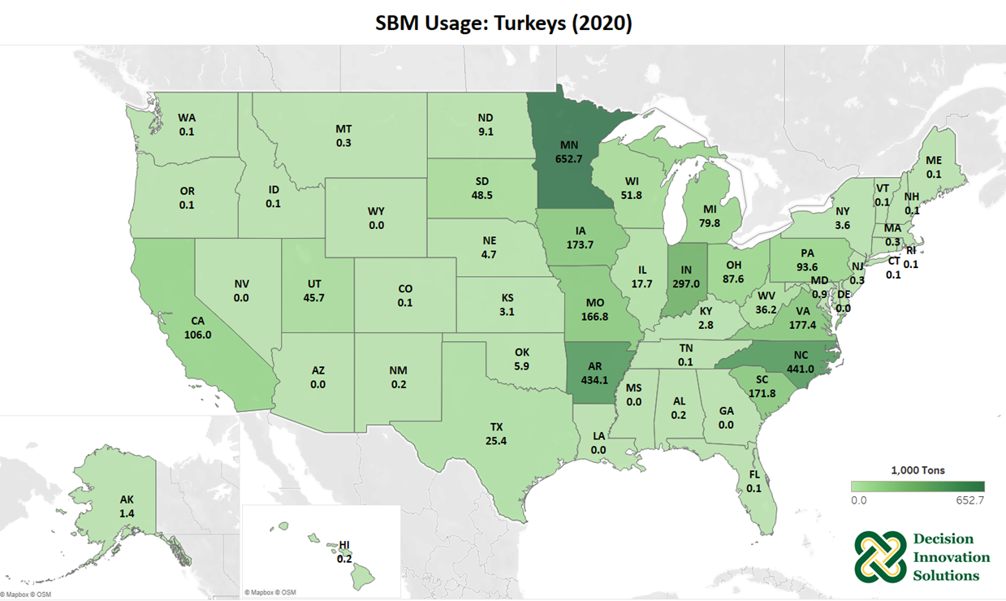
Notes:
Minnesota was the leading state for turkey production and consumed about 652,725 tons of soybean meal by the state’s turkeys in 2020. North Carolina, Arkansas, Indiana and Virginia turkeys also consumed large amounts of soybean meal.

Slide 22
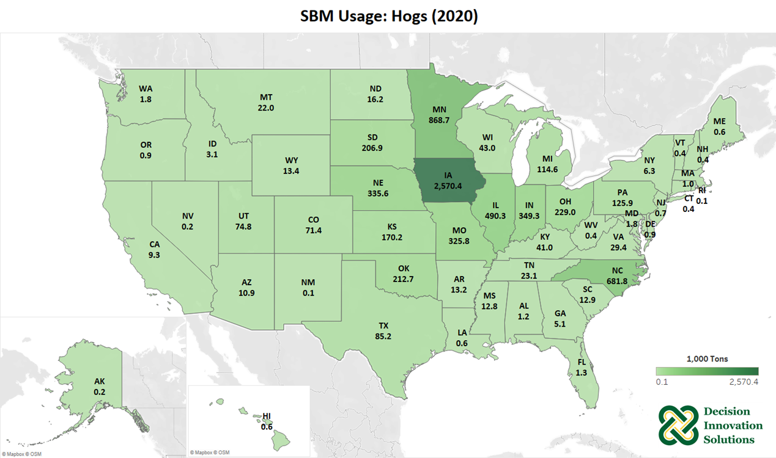
Notes:
Iowa leads the nation in hog production and the state’s hogs consumed nearly 2.6 million tons of soybean meal in 2020. Hogs in Minnesota, North Carolina, and Illinois also consumed large amounts of soybean meal in 2020.

Slide 23
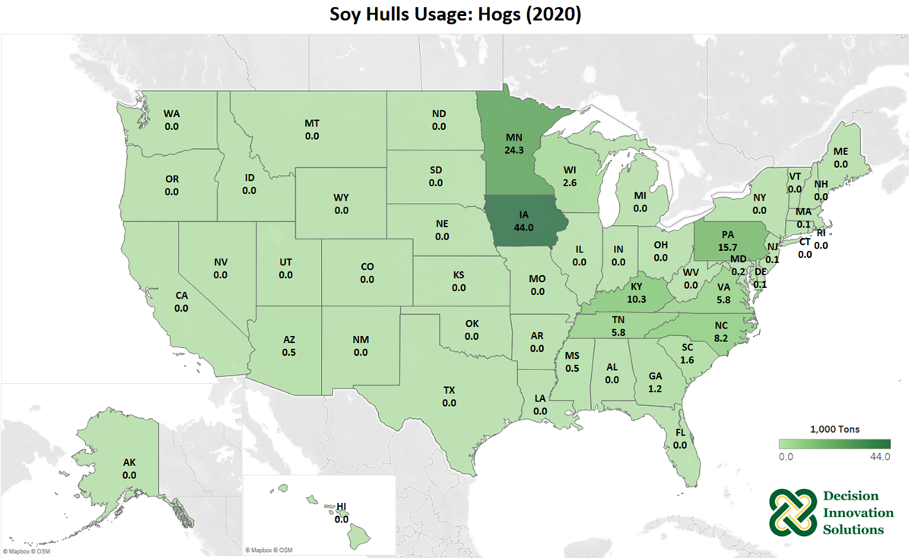
Notes:
In 2020, hogs in Iowa and Minnesota consumed about 44,013 and 24,252 tons of soy hulls, respectively, as the leading states in hog consumption of soy hulls.

Slide 24
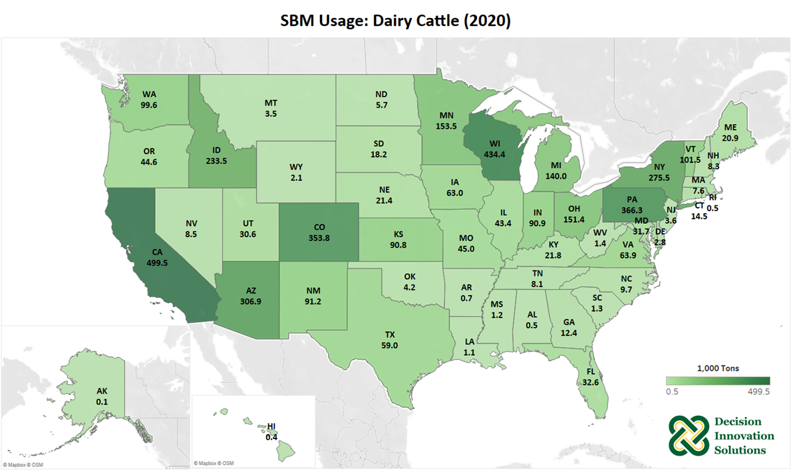
Notes:
In 2020, California and Wisconsin’s dairy cattle consumed about 499,474 and 434,353 tons of soybean meal, respectively, as the leading states in dairy cattle consumption of soybean meal.

Slide 25
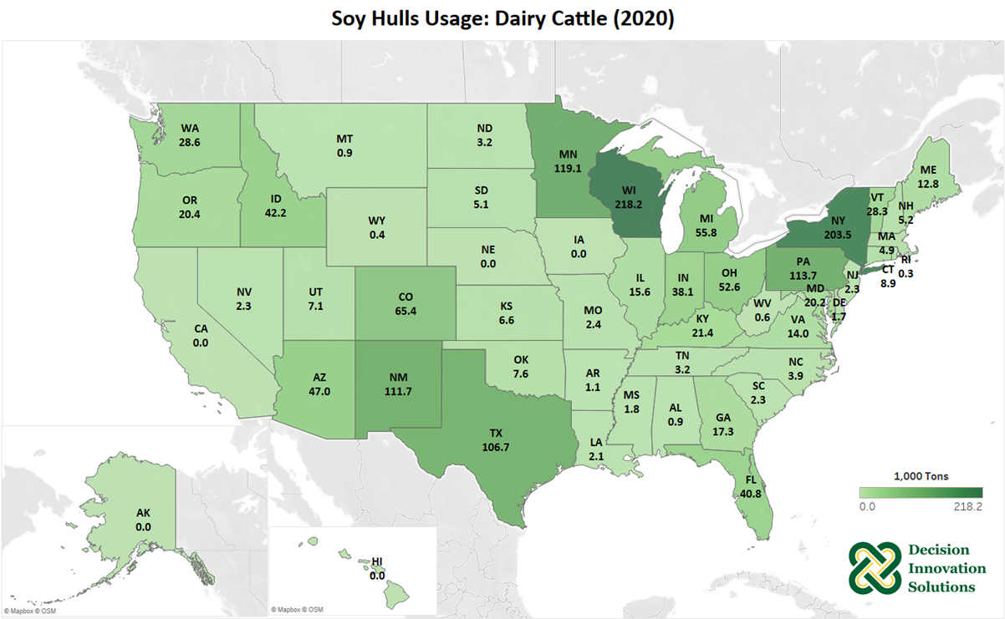
Notes:
Dairy cattle in Wisconsin and New York consumed about 218,226 and 203,529 tons of soy hulls in 2020, respectively, as the leading states in dairy cattle consumption of soy hulls.

Slide 26
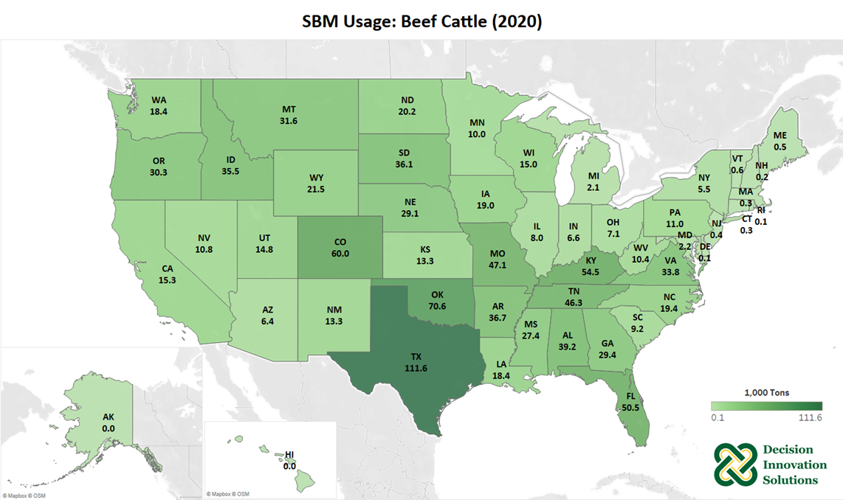
Notes:
Texas’s beef cattle consumed about 111,614 tons of soybean meal in 2020. Beef cattle in Oklahoma, Colorado, Kentucky and Florida also consumed over 50,000 tons of soybean meal each in 2020.

Slide 27
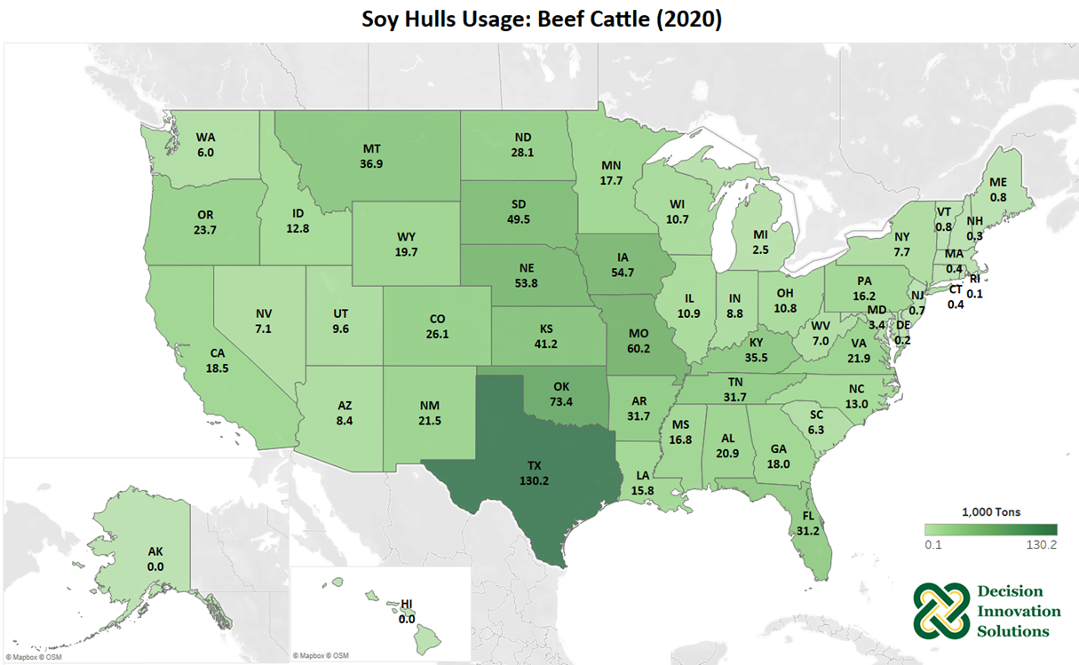
Notes:
Texas beef cattle consumed about 130,209 tons of soy hulls in 2020. Beef cattle in Oklahoma, Missouri, Iowa, and Nebraska also consumed greater than 50,000 tons of soy hulls in 2020.

Slide 28
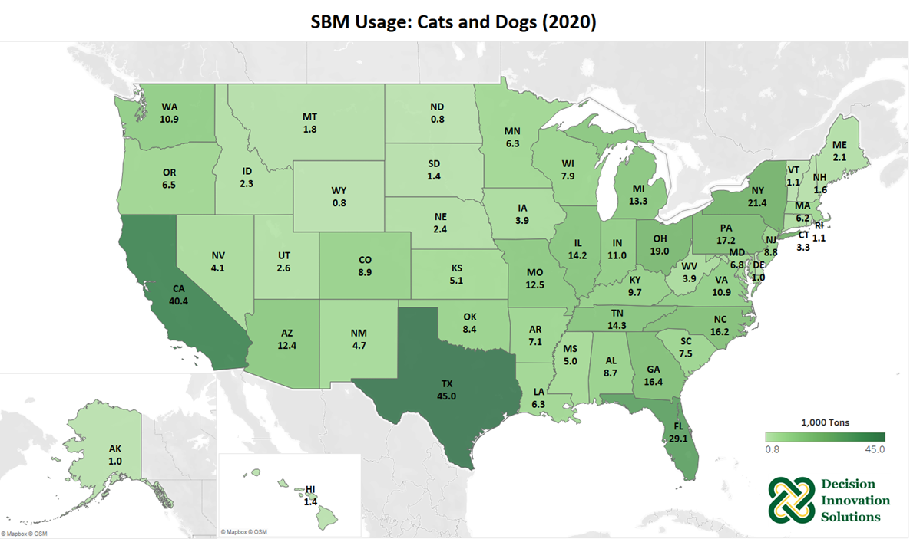
Notes:
The pets considered in this report include cats and dogs. The leading state in soybean meal usage for pets was Texas with about 45,030 tons in 2020. California and Florida also had significant amounts of soybean meal usage by pets with about 40,352 and 29,127 tons, respectively in 2020.

Slide 29
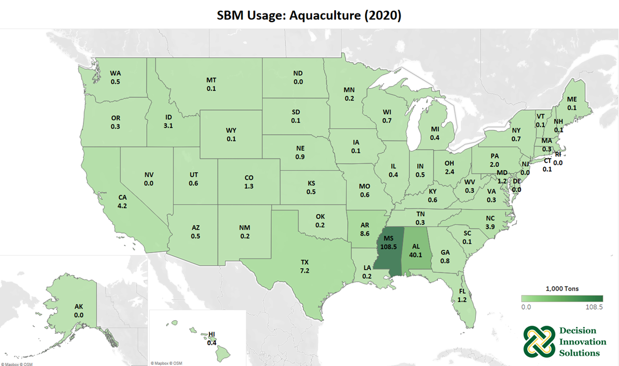
Notes:
This 2020 study includes catfish, trout, tilapia, hybrid striped bass, yellow perch, shrimp, baitfish, and carp in estimates for aquaculture consumption of soybean meal. Most soybean meal consumed in the aquaculture category is in Mississippi and Alabama, with about 108,523 and 40,082 tons, respectively in 2020.

Slide 30
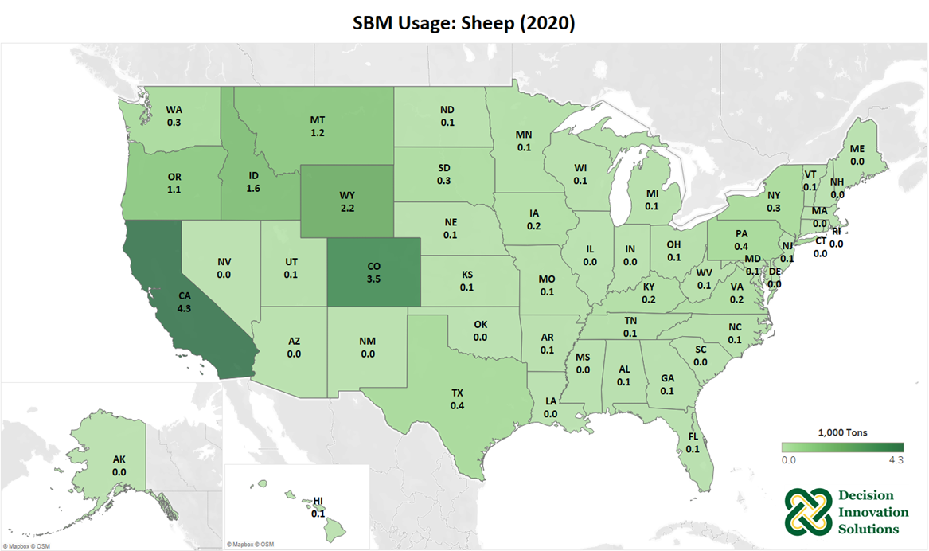
Notes:
California was the leading state for soybean meal usage in sheep production in 2020 with about 4,341 tons, followed by Colorado, with 3,515 tons of soybean meal consumption. Many other states across the West also used between 1,000 and 2,000 tons of soybean meal for sheep production.

Slide 31
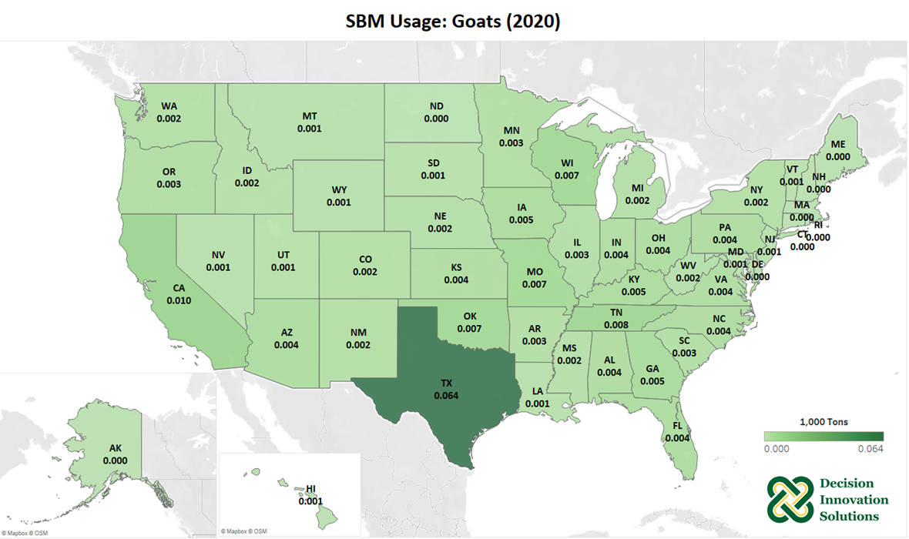
Notes:
Texas had the most soybean meal usage in goats with about 64 tons in 2020. Overall, soybean meal usage for meat goats is minimal in most states across the U.S.

Slide 32
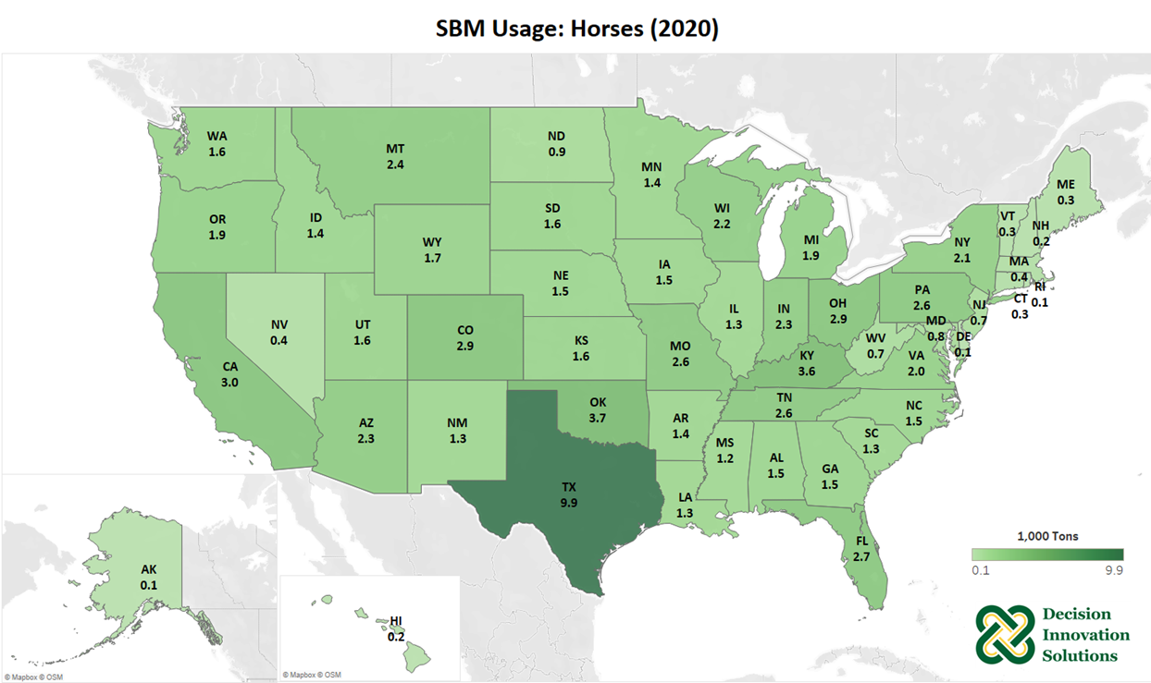
Notes:
Texas was the leading state for soybean meal usage in horses in 2020 with about 9,877 tons. Horses in Oklahoma and Kentucky also consumed greater than 3,000 tons of soybean meal in 2020.

Slide 33
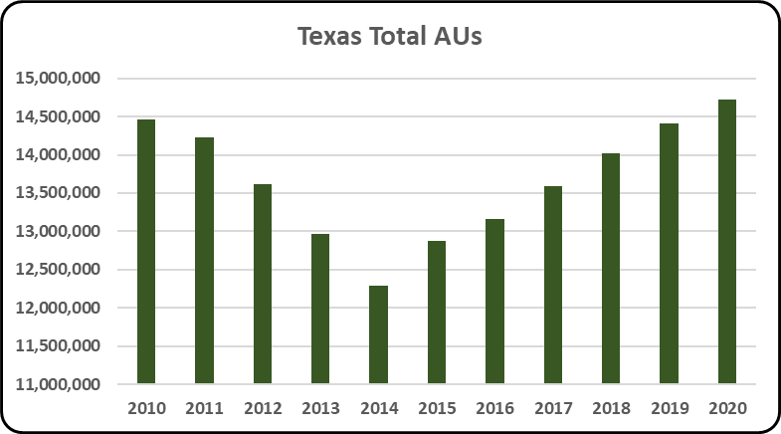
Notes:
The use of animal units allows for a more accurate comparison of differing sizes of livestock and poultry.
The average total AUs from 2010 to 2020 was 13.67 million in Texas. Total AUs were 14.72 million in 2020 for all species included in this study. This is an increase of 2.12% from 2019 to 2020. This decrease was mainly due to a combined increase of 324,934 broiler, dairy cattle, and beef cattle AUs.

Slide 34
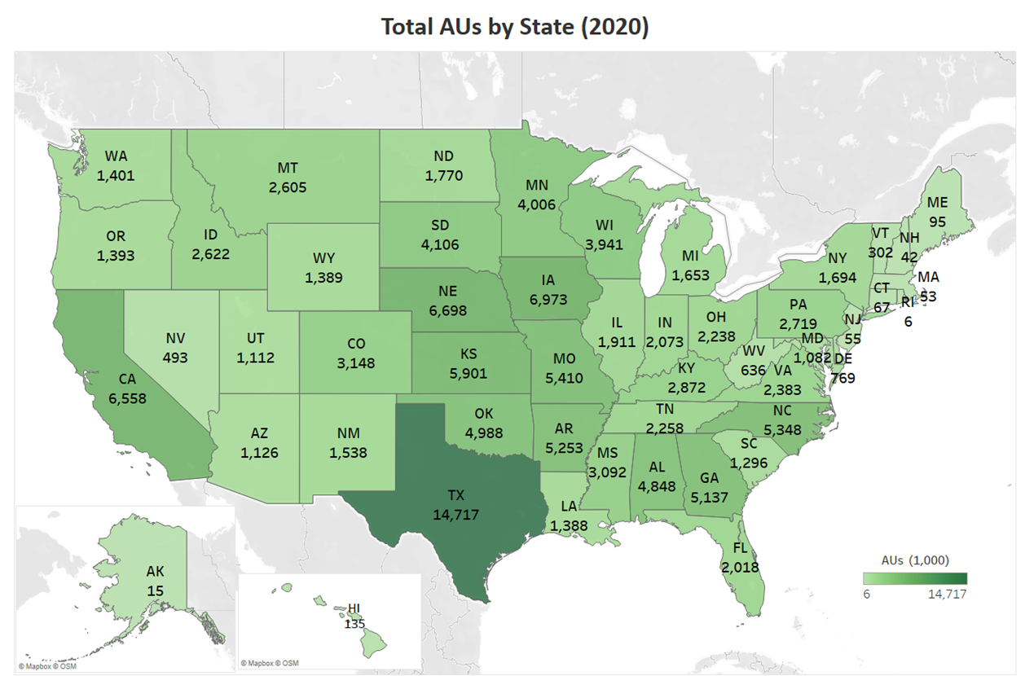
Notes:
The map below represents the combined total number of animal units for all species by state. As shown, Texas was home to almost 15 million animal units in 2020. Iowa and Nebraska follow with 7.0 and 6.7 million AUs, respectively.

Slide 35
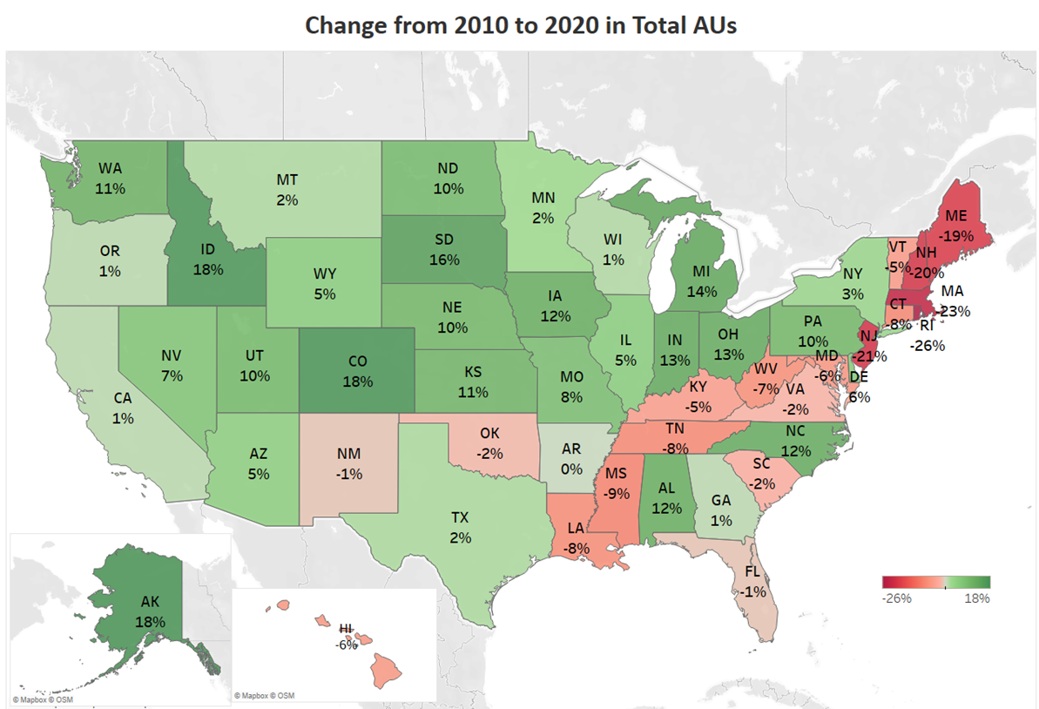
Notes:
States across the southern and eastern parts of the U.S. saw declines in total animal units from 2010 to 2020, while many Midwestern states saw increases in animal units. Cattle and hog production declining in many southern states and increases in Midwestern states contributed to changes in animal units. Texas, the leading state in total animal units in 2020, increased by 2% from 2010 to 2020, and Iowa increased by 12%.

Slide 36
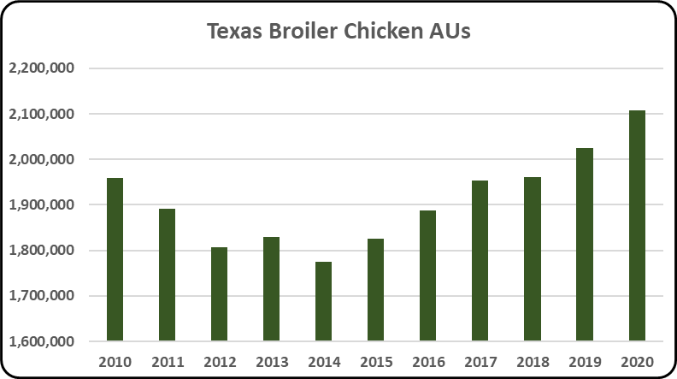
Notes:
Texas’s average broiler AUs during 2010 - 2020 were 1.91 million. In 2020 there was a 4.07% increase in broiler AUs from 2019 values, for a total of 2.11 million broiler AUs. Broiler AUs in Texas have increased by 7.53% since 2010. Furthermore, broilers are the second largest animal sector in the state accounting for 14.32% of the total AUs (14.72 million), in Texas.

Slide 37
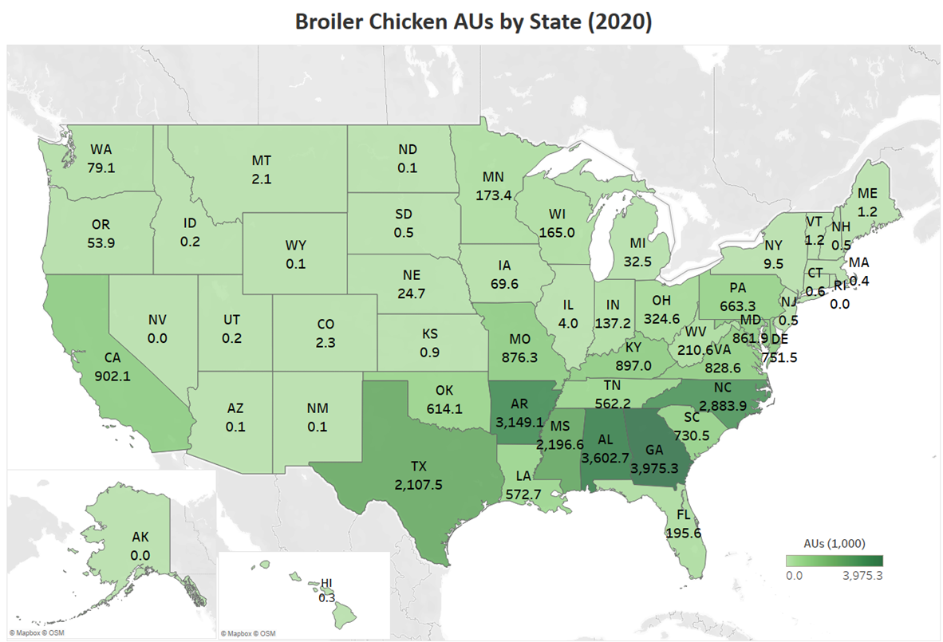
Notes:
U.S. broiler chickens are heavily concentrated in the southeastern states of Georgia, Alabama, Arkansas, North Carolina and Mississippi. About 14% of the nation’s broiler chickens were located in Georgia, while Alabama and Arkansas house 13% and 11% of the broiler chickens in the U.S., respectively.

Slide 38
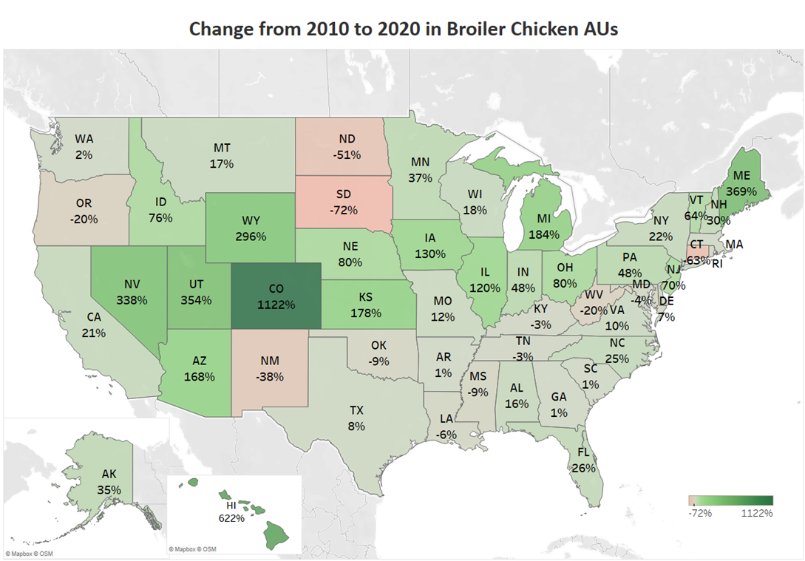
Notes:
This map shows that many states across the West and Midwest saw a large percent changes in broiler chicken animal units from 2010 to 2020, but it is important to remember that these states do not have many broilers. States that have high broiler numbers like Alabama and North Carolina each saw increases of 16% and 25%, respectively, in animal units during the last decade. Alabama and North Carolina accounted for a large increase in total broiler AUs, and Arkansas, Georgia, and South Carolina also increased slightly, about 1%. Massachusetts and Rhode Island had no broiler AUs at the beginning of the ten-year period, but began seeing very low broiler AU numbers in 2012.

Slide 39
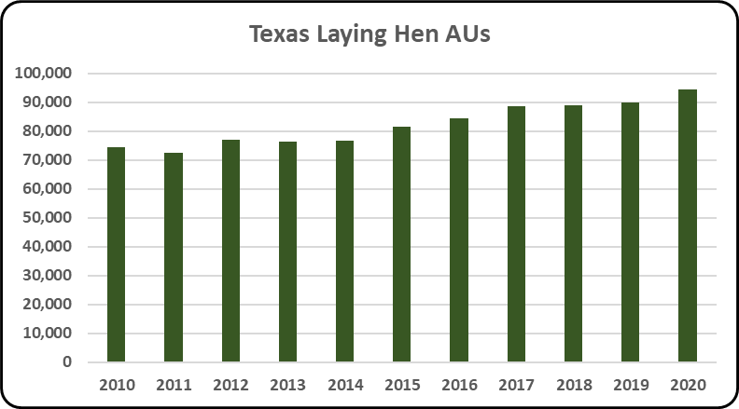
Notes:
Texas’s average layer AUs during 2010 - 2020 were 82,315. In 2020 there was a 5.26% increase in layer AUs from 2019 values, for a total of 94,656 layer AUs. Layer AUs in Texas have increased by 27.08% since 2010 and account for 0.64% of the total AUs (14.72 million) in Texas.

Slide 40
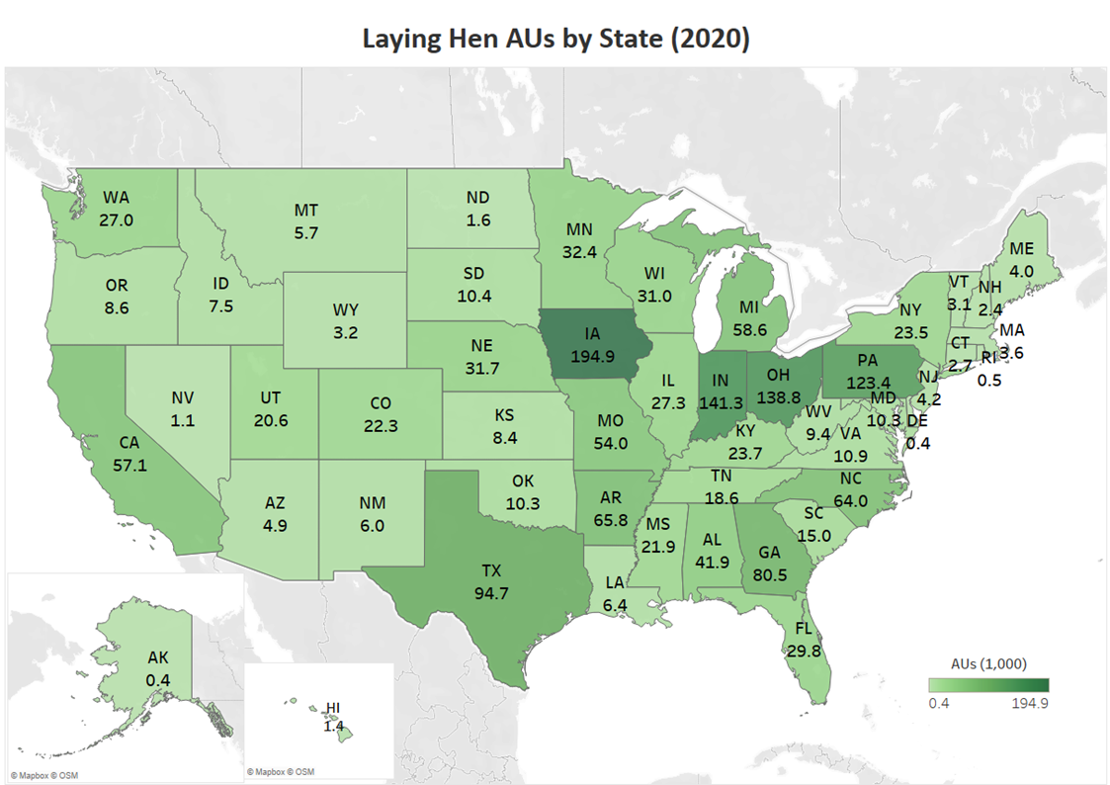
Notes:
Laying hen animal units in Iowa decreased slightly from 2018, but are up from only 150,000 AUs in 2015, which shows recovery in the industry from the losses due to the avian influenza outbreak. Iowa accounts for more than 12% of all laying hen AUs in the U.S. Other top states for laying hens include Indiana, Ohio, and Pennsylvania.

Slide 41
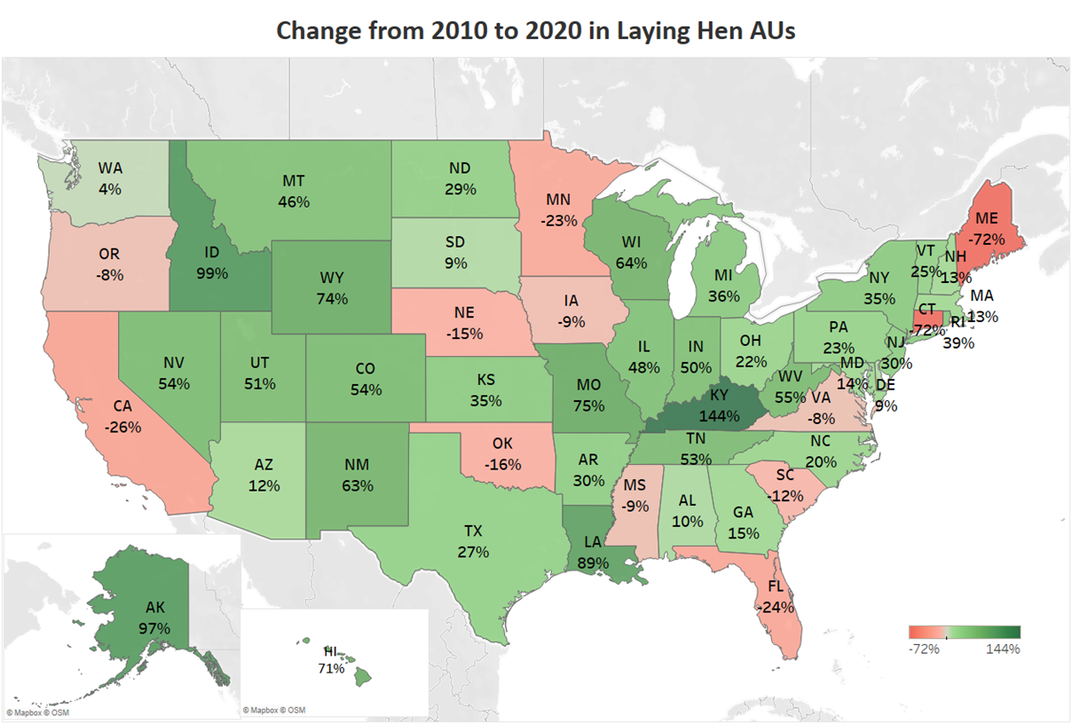
Notes:
Iowa has recovered from the avian influence losses in 2015, but had a 9% decrease in laying hen AUs over the last decade. States such as Kentucky, Idaho, Alaska, and Louisiana saw large percentage increases, but in real terms of animal units those numbers are small.

Slide 42
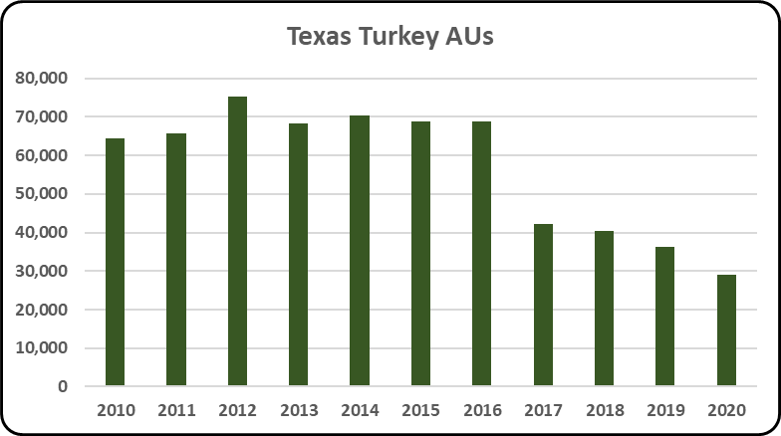
Notes:
In 2020, Texas had 29,127 turkey AUs, a 19.80% decrease from 2019. Furthermore, turkeys account for 0.20% of the total AUs (14.72 million) in Texas. Turkey AUs in Texas have decreased by 54.83% since 2010. The average turkey AUs from 2010 – 2020 is 57,284

Slide 43
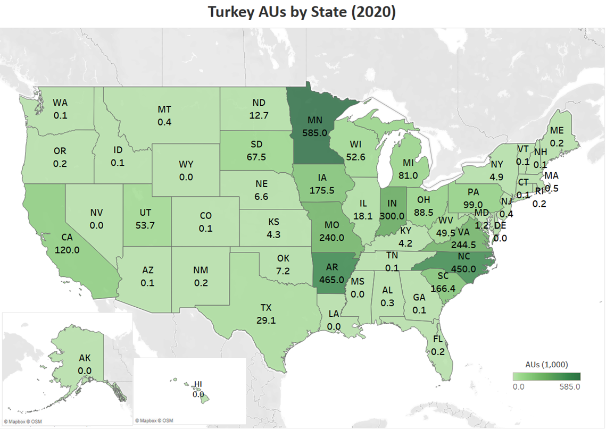
Notes:
In 2019, Minnesota has the highest turkey animal units at 585,000, which was about 18% of the total U.S. turkey animal units. Other top states include Arkansas (14%), North Carolina (14%), Indiana (9%), Virginia (7%), and Missouri (7%).

Slide 44
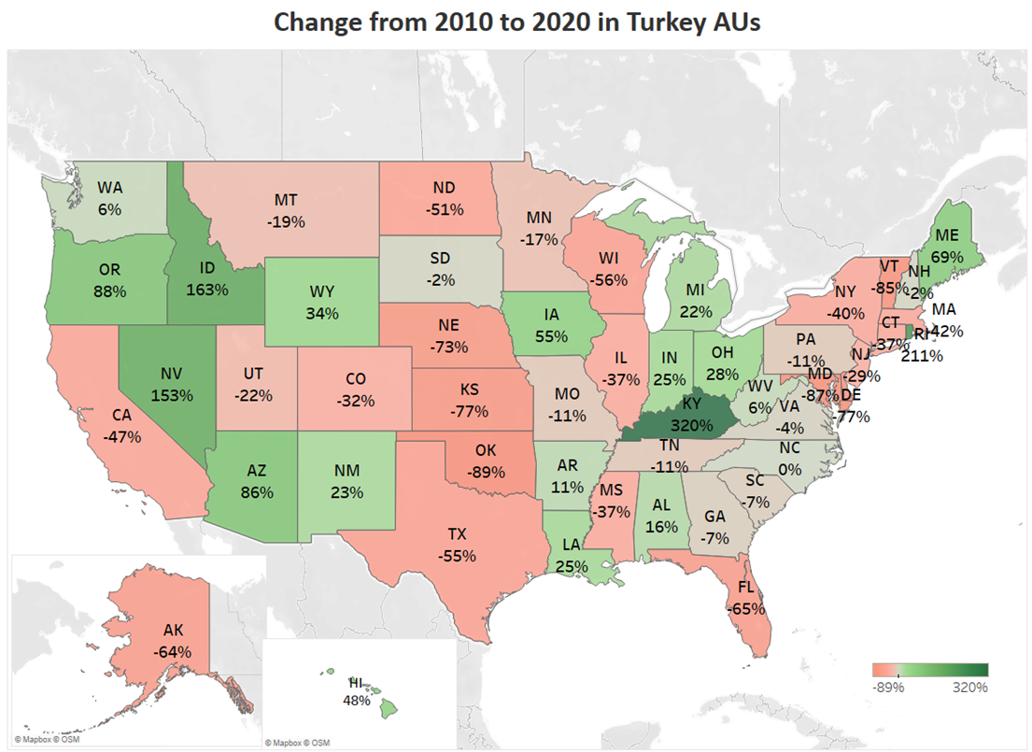
Notes:
Indiana, which is the fourth largest state in turkey animal units, saw a 25% increase from 2010 to 2020, while the largest state in terms of turkey animal units, Minnesota, showed a decline of about 17% over the same time period. Kentucky, Idaho, Nevada, Oregon, and Arizona saw large percentage increases in turkey animal units, but those states only account for a small portion of U.S. turkey AUs.

Slide 45
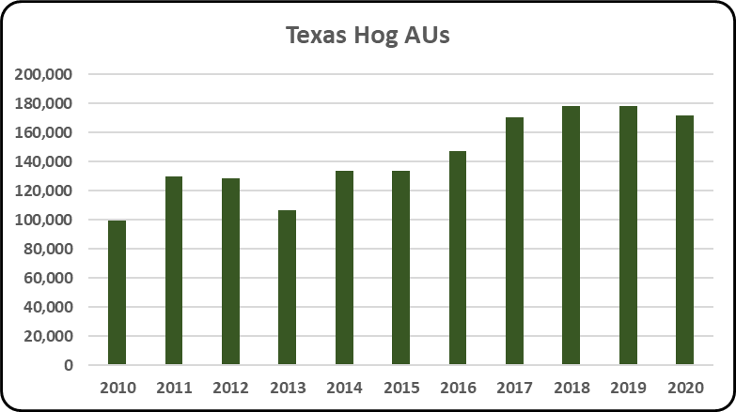
Notes:
In 2020 Texas had 171,929 hog AUs, a 3.38% decrease from 2019 levels. Furthermore, hogs accounted for 1.17% of the total AUs (14.72 million) in Texas. From 2010 to 2020, the average number of hog AUs in Texas was 143,362. Hog AUs have increased by 72.45% since 2010.

Slide 46
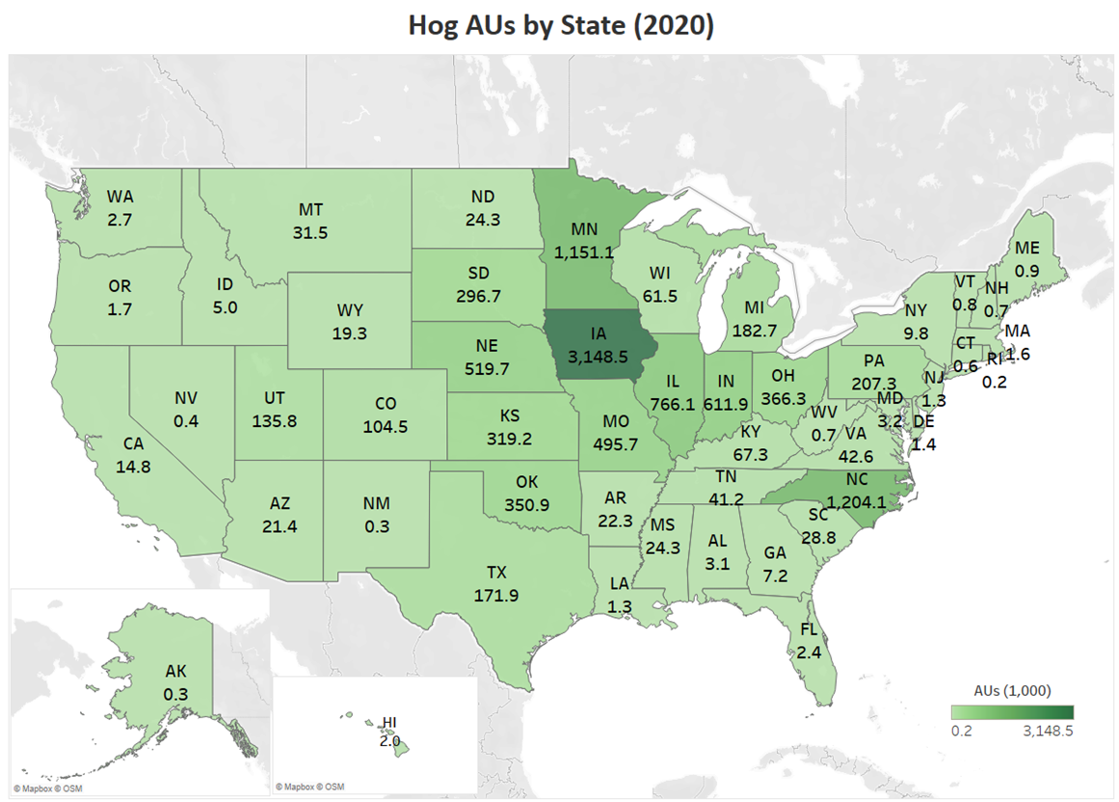
Notes:
Iowa, Minnesota and North Carolina were the states that housed the most hog animal units in 2020. Iowa accounts for 30% of the nation’s hog animal units while North Carolina and Minnesota each house an additional 11% of total U.S. hog AUs.

Slide 47
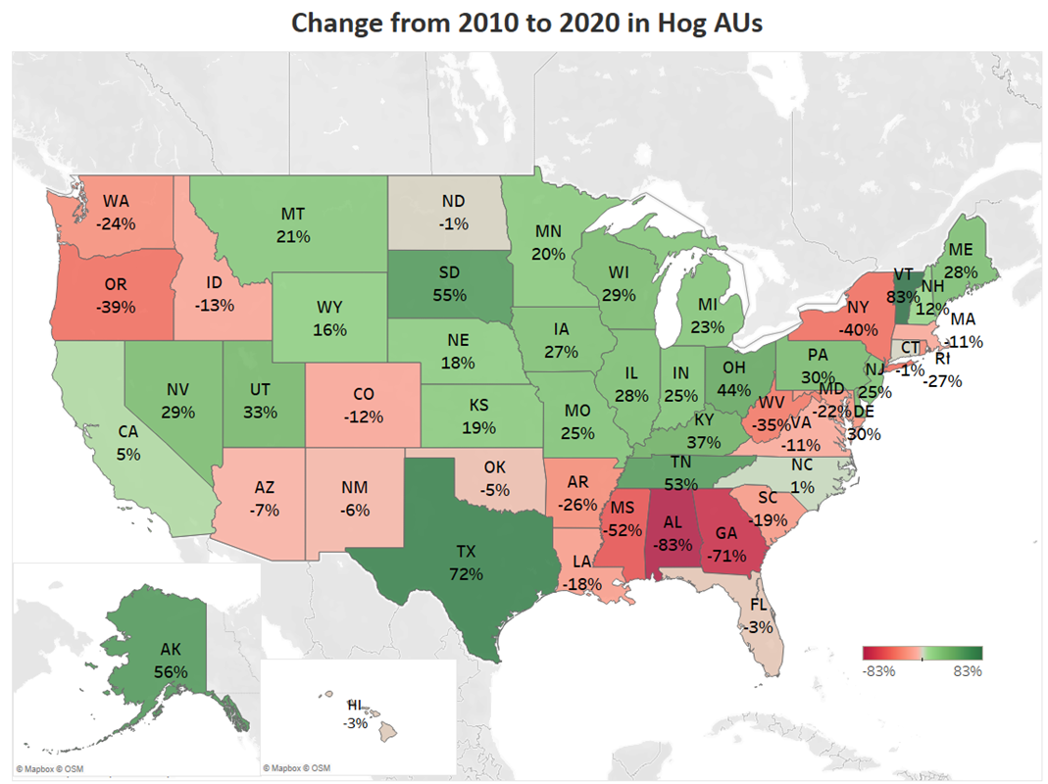
Notes:
Iowa, the leading state in hog production, saw a 27% increase from 2010 to 2020 in hog animal units. Minnesota, Illinois, and Indiana increased more than 20% over the same period. However, North Carolina, the second largest state in terms of AUs, almost maintained at the same level, by increasing about 1% from 2010 to 2020. Since 2010, total US hog AUs have increased 27% due to growing numbers in many Midwest states.

Slide 48
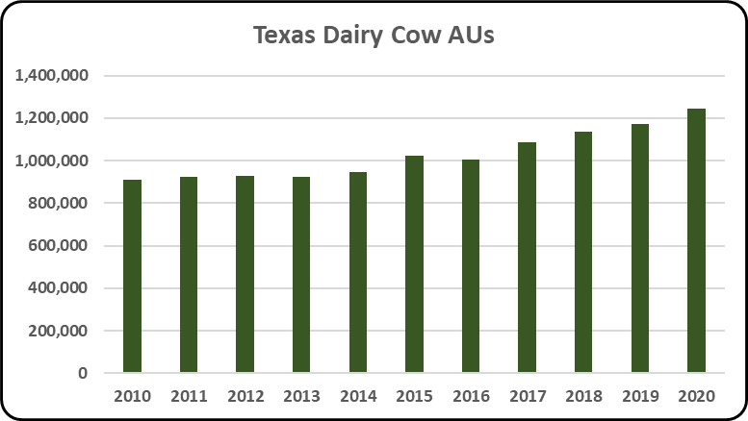
Notes:
In 2020 Texas had 1.25 million dairy cattle AUs, a 6.42% increase from 2019 levels. Furthermore, dairy cattle account for 8.47% of the total AUs (14.72 million) in Texas making it the third largest animal sector. From 2010 to 2020, the average number of dairy cattle AUs in Texas was 1.03 million. Dairy cattle AUs have increased by 37.30% since 2010.

Slide 49
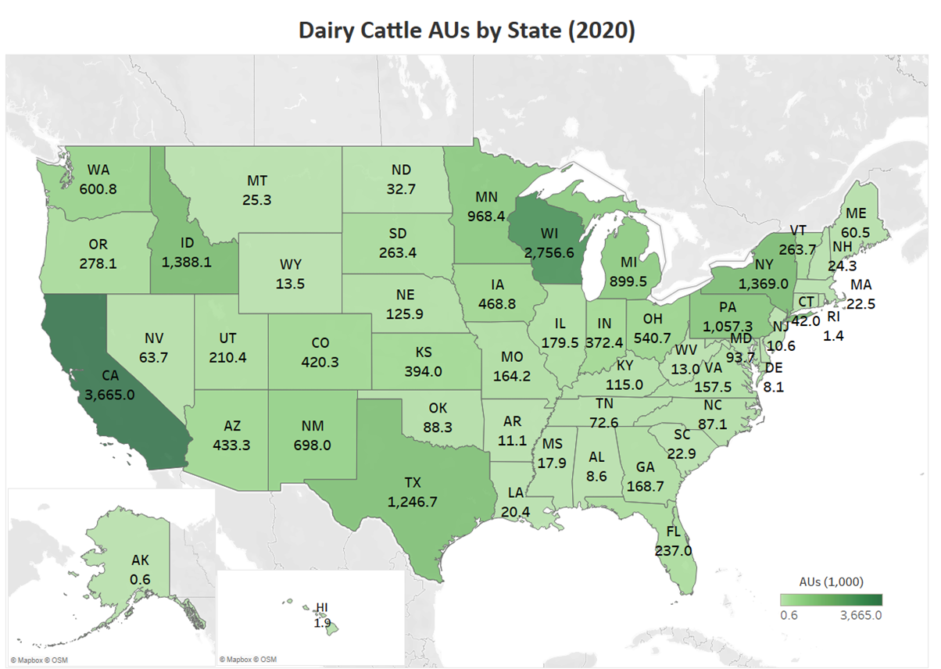
Notes:
California and Wisconsin are the leading states for dairy cattle with nearly 3.7 and 2.8 million animal units, respectively in 2020. Idaho, New York, Texas, and Pennsylvania also had over 1 million animal units from dairy production in 2020.

Slide 50
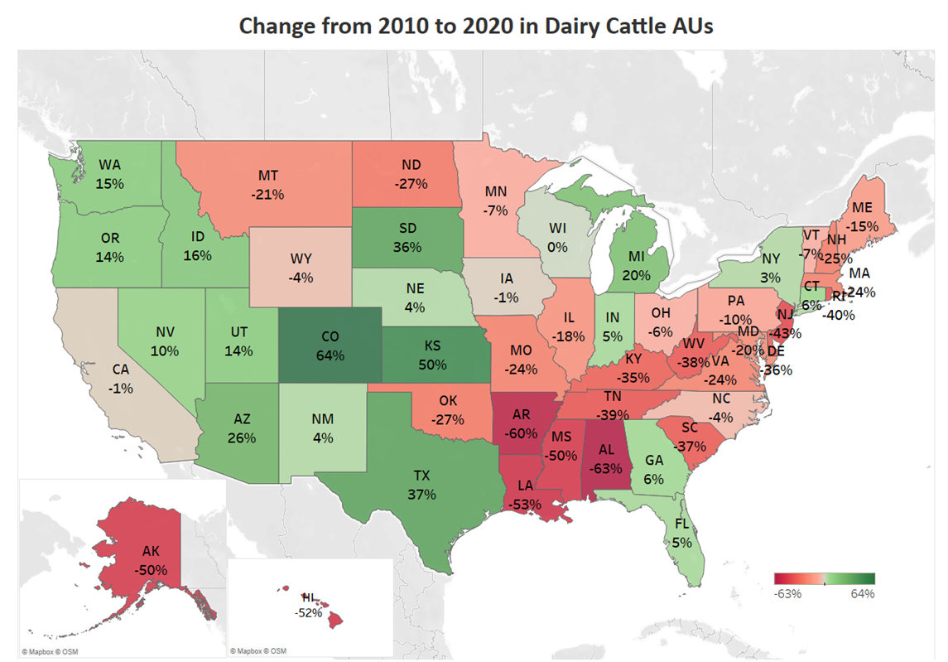
Notes:
Wisconsin, which is known for their large dairy cattle population maintain the same level over the last decade, however California saw a 1% decline. During the same period, Texas, Michigan, and Idaho also increased their dairy cattle animal units by 37%, 20% and 16%, respectively, and are now among the top 10 states for dairy cattle.

Slide 51
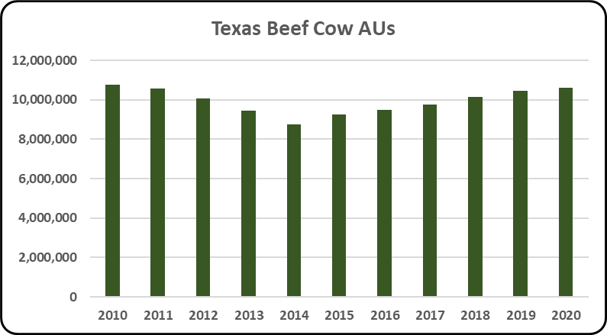
Notes:
In 2020 Texas had 10.63 million beef cattle AUs, a 1.60% increase from 2019 levels. The beef cattle sector is the largest animal sector in Texas accounting for 72.22% of the total AUs (14.72 million) in Texas. From 2010 to 2020, the average number of beef cattle AUs was 9.94 million. Beef cattle AUs have decreased by 1.38% since 2010. Among all 50 states Texas is ranked first in beef cattle Aus.

Slide 52
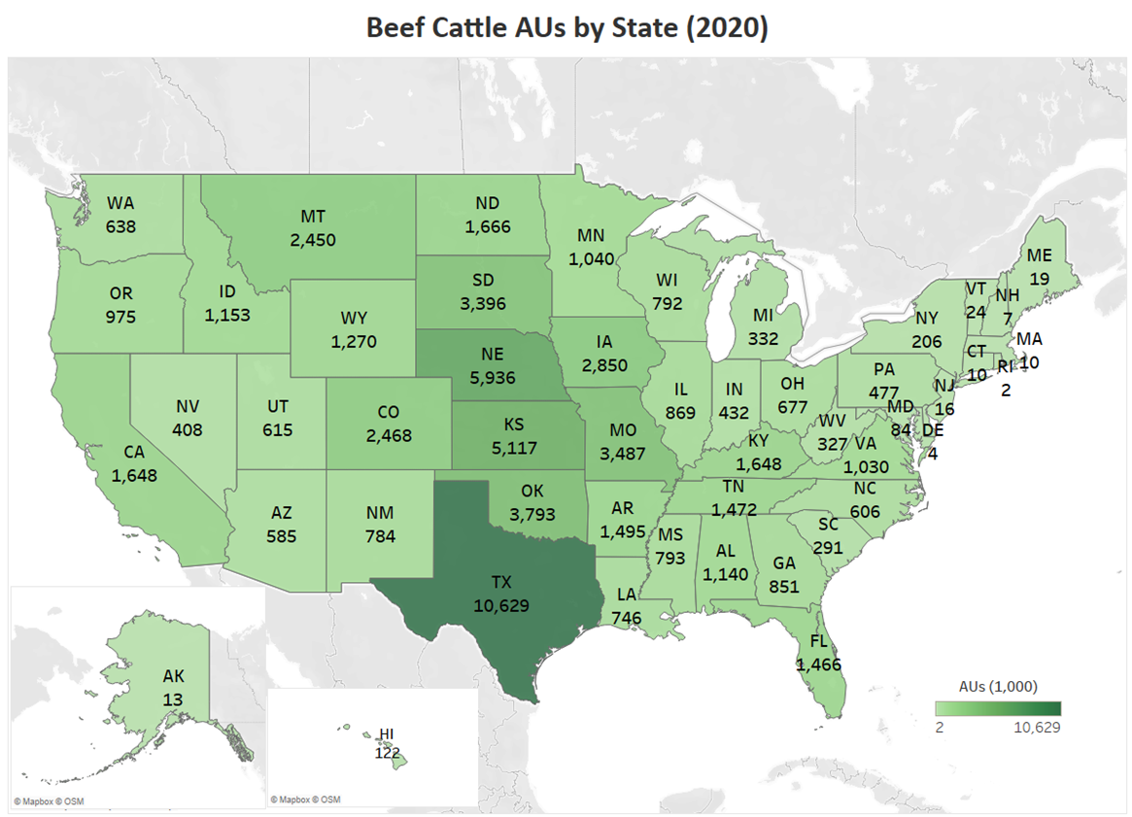
Notes:
Texas, Nebraska, and Kansas are the top three states for beef cattle animal units, with about 10.6, 5.9, and 5.1 million animal units, respectively in 2020. Oklahoma, Missouri, and South Dakota also exceed 3 million animal units of beef cattle.

Slide 53
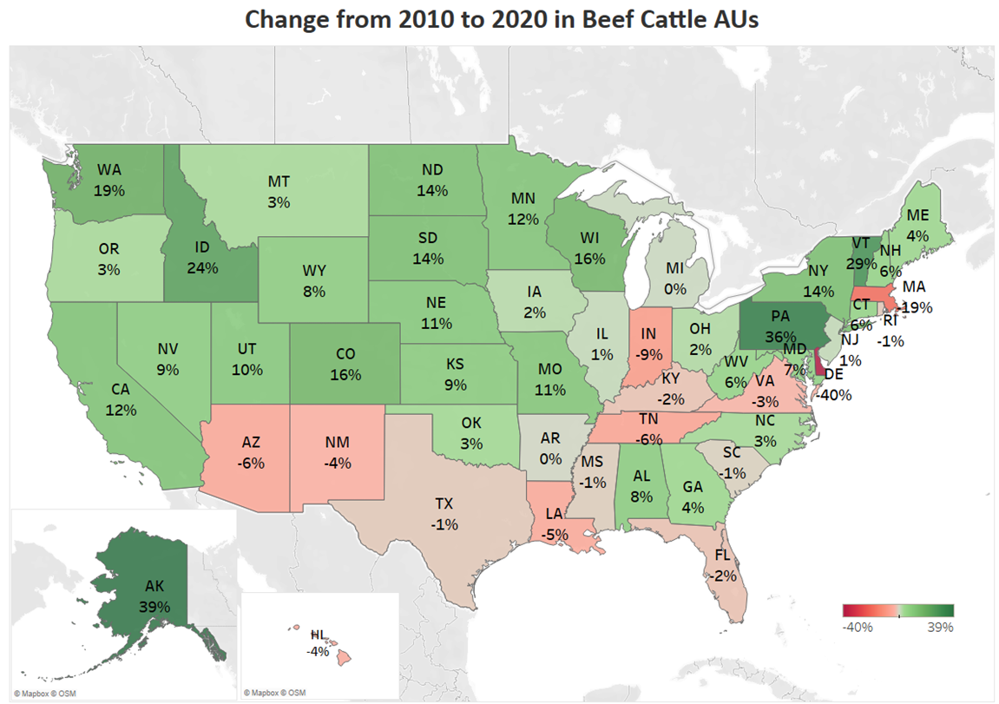
Notes:
Nebraska saw a 11% increase in beef cattle animal units from 2010 to 2020, while Texas saw a 1% decline. Extremely dry periods during 2011-2013 had a significant impact on movement of cattle from states such as Texas and Kansas further north to Nebraska, Iowa, Minnesota, and other states.

Slide 54
Notes:
Ranked first among all 50 states for sheep, dairy goat, and meat goat AUs Texas had a combined 148,150 AUs, a 1.51% increase from 2019 levels. These account for 1.01% of the total AUs (14.72 million) in Texas. Individually, sheep and meat goat AUs decreased by 12.14% and 15.00%, respectively, while dairy goat AUs increased by 45.00% over the decade. Combined, there was a 12.98% decrease in AUs since 2010.

Slide 55
Notes:
Sheep and goats account for less than 1% of total US AUs. Texas leads all states in meat goat and sheep production with 20% of total sheep and goat AUs. Other top states include California (9%), Colorado (6%), Wyoming (5%), and Utah (4%). Wisconsin is the top dairy goat producer with 18% of total dairy goat AUs. And Texas is the top meat goat producer with 37% of total meat goat AUs.

Slide 56
Notes:
Sheep and goat AUs in the US have declined 7.9% from 2010 to 2020. Only 14 states had a positive change in AUs that was greater than 2%. Wisconsin, the leading dairy goat production state, saw an 64% increase in dairy goat AUs but a 9.2% decrease in both sheep and meat goat AUs. States with positive growth were mostly small producing states like Hawaii and Alaska.

Slide 57
Notes:
In 2020 Texas had 289,856 horse AUs, a 4.52% decrease from 2019 levels. Horse AUs account for 1.97% of the total AUs (14.72 million) in Texas. The decade average number of horse AUs was 351,526. Horse AUs have experienced an overall decrease of 29.68% since 2010. Texas is ranked first in horse AUs among all 50 states.

Slide 58
Notes:
Horses account for about 2% of total US AUs. Texas leads all states in horse production with 12% of total horse AUs. Other top states include Oklahoma (4%), Kentucky (4%), California (3%), and Colorado (3%).
AUs for horses is a new content added in this year (FY21). Horse AU calculation is only from USDA Census of Agriculture inventory number. Please find out more details under the Methodology section.

Slide 59
Notes:
Horse AUs in the US have declined 34% from 2010 to 2020. Only Arizona had a positive change in AUs that was greater than 6%. Texas, Oklahoma, and Kentucky, the leading three horse production states, saw about 30% decrease in horse AUs.

